Slide 1
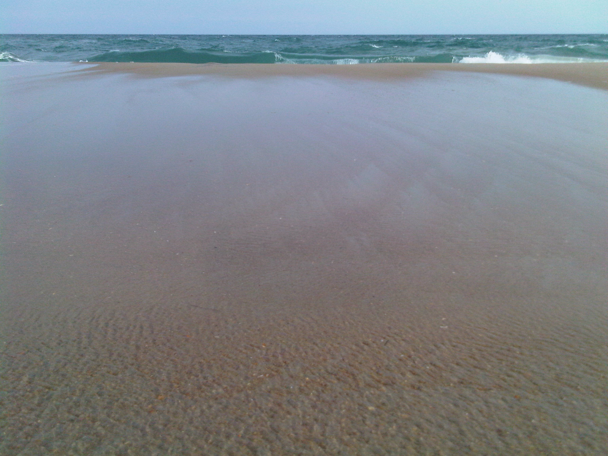

Vacation Time is Here…It’s Time to Relax!
We have shut down for our annual summer break from July 12th to July 21^{st.} We appreciate your patience and understanding while Mendi and Thomas spend time away with their families.
We will not be shooting or processing any tours during this break. You are welcome to place orders to be shot when we get back. Mendi will be able to coordinate with you on scheduling.
The MailBlast ordering form will continue to be disabled until we are back in town.
Hopefully you have a chance to spend some quality time with your loved ones this summer. We know this temporary shut-down can impact your marketing and we apologize for any disruption this downtime may cause you.
Fear Not! We will be back to our normal full-service 24-hour delivery beginning July 22nd!
support@cvh360.com | cvh360.com
Thomas 843-224-6359 | Mendi 843-323-6236

