Slide 1
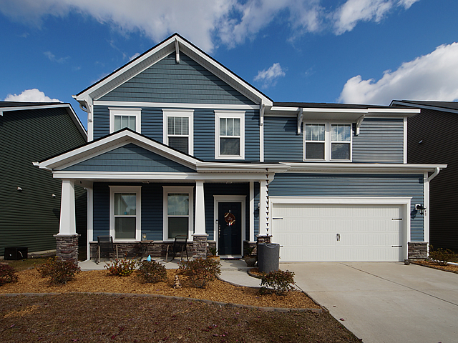
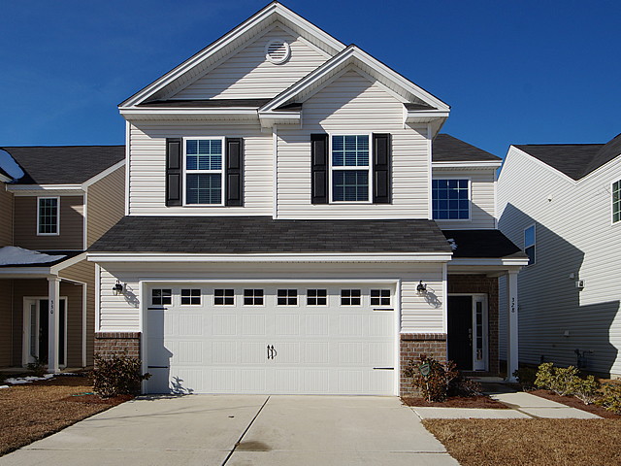
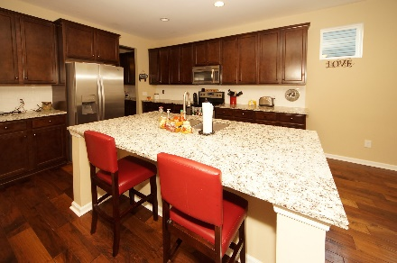
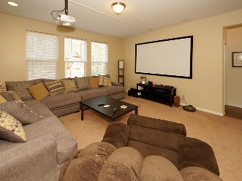
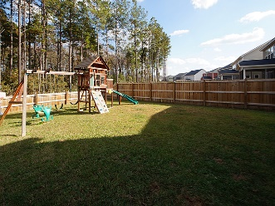
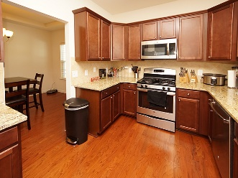
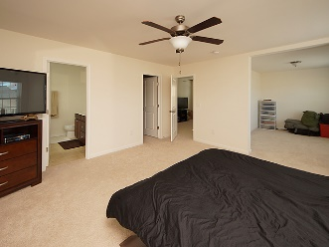


348 Beachgrass Ln MLS# 17031895 :: $350,000 5 Bed / 3 Bath
Just Reduced $785,000!
Cane Bay Plantation Parade of Open Houses
Saturday, January 27th from 11am-2pm
328 Beautyberry Rd MLS# 18000459 :: $235,000 5 Bed / 3 Bath
$32,000 in upgrades
Includes "cinema/entertainment"
In beautiful Lindera Preserve
Neighborhood includes "splashzone" and Playpark!
Connie White, Broker
843-532-3356
conniesyouragent@gmail.com
Charleston Homes · 597 Old Mt. Holly Road · Suite 301 · Goose Creek, SC 29445

