Slide 1
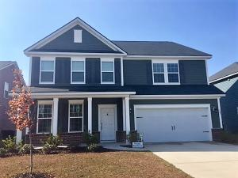
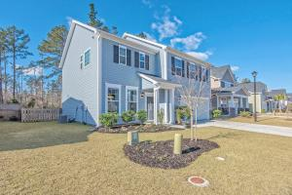
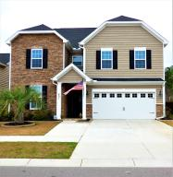
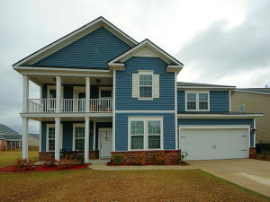
Cane Bay Plantation Multiple Listing Broker Open House
Thursday March 23rd ~ 11:30am - 1:30am
Lunch and dessert will be served.
Also, there will be TWO $50 gift card drawings! Agents must attend all open houses to enter the drawing.
327 Beachgrass
MLS# 16029645 ~ $309,999
Jennifer Hale
843-708-0698
jennifer.hale@cbcarolinas.com
Coldwell Banker Residential Brokerage
331 Spectrum Road
MLS# 17003766 ~ $257,750
Kathy Tatum
843-860-3031
ktatum@century21properties.com
Century 21 Properties Plus
497 Whispering Breeze Lane
MLS# 17004884 ~ $365,000
Anna Propst
843-426-6215
annapropstrealestate@gmail.com
The Real Estate Firm
106 Basket Grass Lane
MLS# 17007387 ~ $319,912
Rhonda Tudor
843-709-8800
rhonda_tudor@yahoo.com
Coldwell Banker Residential Brokerage

