Slide 1


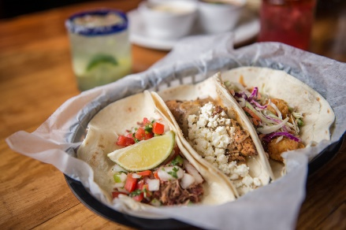
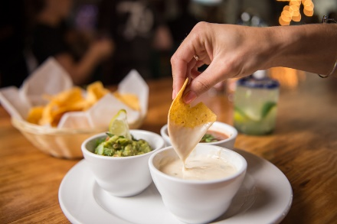
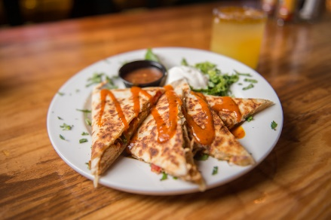
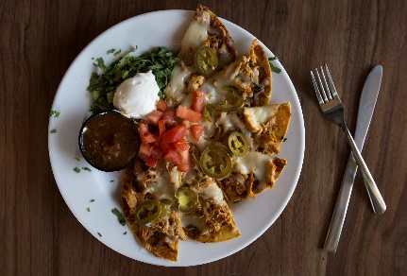
Realtors – looking for a great to-go meal option?
Cantina 76 is a lively, independently-owned restaurant that specializes in American taqueria cuisine, providing a fast yet satisfying casual dining experience. This comfortable, inviting restaurant is a go-to for families, couples, young professionals, the business community and college students – perfect for a dinner to be bring home to your family or a quick meal with coworkers during a lunch break.
Take-out lunch and dinner are served seven days a week. So if you're out and about doing the rewarding work of real estate, call ahead and have a wonderful meal ready for you to take back to your car, office, or home!
MOTIVATED SELLER!! REDUCED 150K!
Check out our menu online for this week's specials, give us a call at 843-388-7717 to place your order, then swing by to pick-up your meal.
www.cantina76.com
819 Coleman Boulevard
Mount Pleasant, South Carolina, 29464
843-388-7717
Kitchen Hours
Monday - Tuesday
11:00 a.m. - 9:30 p.m.
Wednesday - Saturday
11:00 a.m. - 10:00 p.m.
Sunday
11:00 a.m. - 9:00 p.m.

