Slide 1
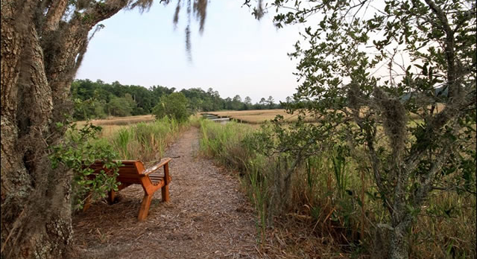
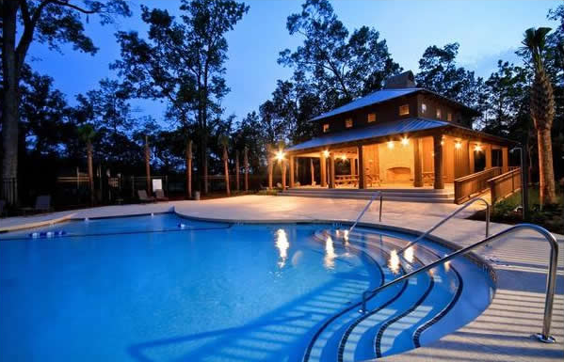
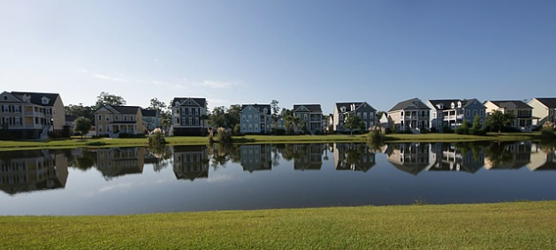
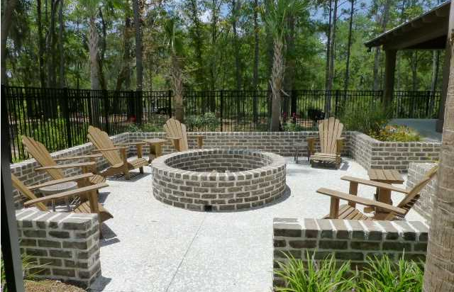

Qualified Buyer Looking for 4 Bedroom Home in Carolina Bay, Master Up, that is not on the market. Please call me if you have a Pocket Listing!
Pre-Qualified Buyer Looking in Carolina Bay
Robin Phillips
(843) 214-8451
Robin@ThePhillipsRealtyGroup.com

