Slide 1
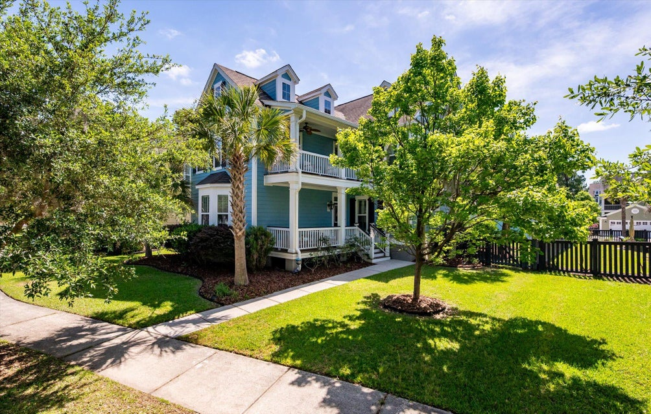
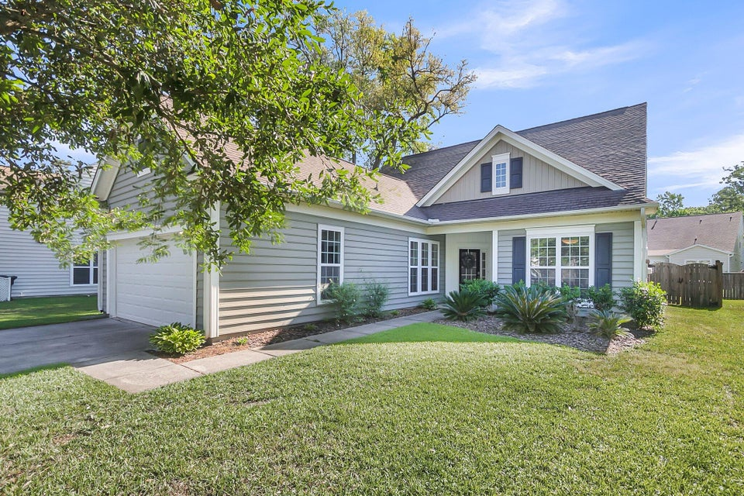

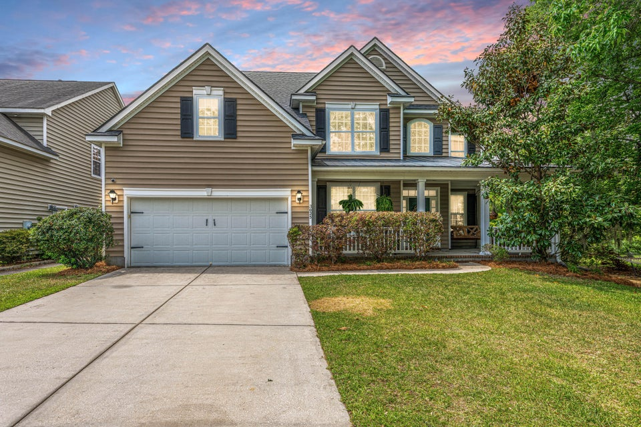

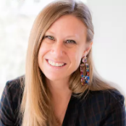
Carolina Bay Open House Event | Friday, June 20th from 3-5
2627 Rutherford Way
MLS# 25012729
$730,000
4 Bed | 3½ Bath | 2,708sf
Carey Nikonchuk
843-276-1701
cnikonchuk@gmail.com
The Brennaman Group
1572 Pixley Street
MLS# 25212228
$609,999
4 Bed | 3 Bath | 2,500sf
Brent Boatwright
843-819-2121
brent@ashleycooperrealestate.com
Ashley Cooper Real Estate, LLC
3025 Buckeley Circle
MLS# 25011312
$625,000
5 Bed | 3 Bath | 2,777sf
Shana Swain
843-224-8400
shana.swain@carolinaoneplus.com
Carolina One Real Estate

