Slide 1
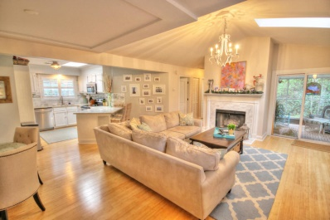
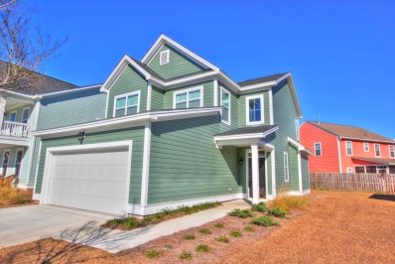
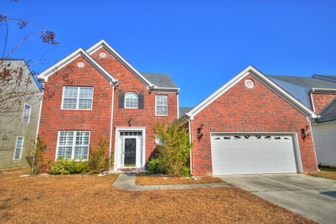
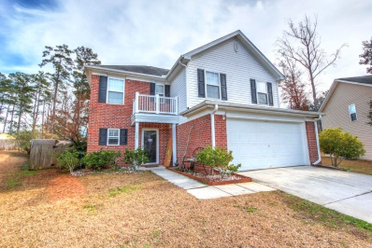
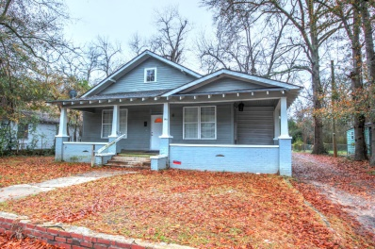
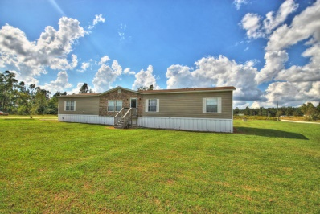
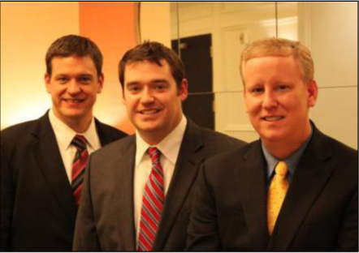

ChuckTown Homes New Listings!!
Under Contract
in 6 Days!
Under Contract
in 11 Days!
Under Contract
in 11 Days!
Under Contract
in 15 Days!
Chelsea Park
Mt Pleasant
$325,000
MLS# 14031647
Nelliefield Plantation
Charleston
$250,000
MLS# 15000581
Click here to view listing
24-hour Information Hotline
888-210-3348 x3649
Click here to view listing
24-hour Information Hotline
888-210-3348 x3679
Buckshire
Summerville
$210,000
MLS# 14031524
Eagle Run
Ladson
$170,000
MLS# 15000618
Click here to view listing
24-hour Information Hotline
888-210-3348 x3759
Click here to view listing
24-hour Information Hotline
888-210-3348 x3129
Orangeburg
Orangeburg
$100,000
MLS# 15000167
Reevesville
Reevesville
$80,000
MLS# 14031117
Click here to view listing
24-hour Information Hotline
888-210-3348 x2019
Click here to view listing
24-hour Information Hotline
888-210-3348 x2069
The ChuckTown Homes Team
Owners:
Donald Russell, Jeremy Wilson, Shawn Pillion
Buyers Specialists:
Andrea Parler, Tammie Phillips, Polly Cillpam,
Ashley Towns, Katie McClure and Steve Baller
Phone: 888-210-3348
info@chucktownhomes.com
www.chucktownhomes.com

