Slide 1
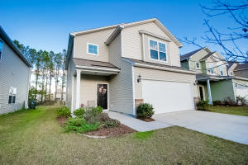
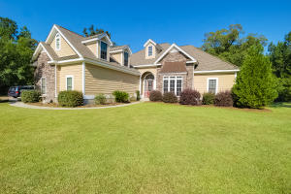
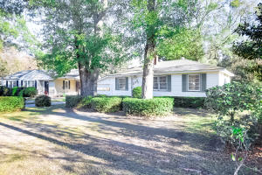
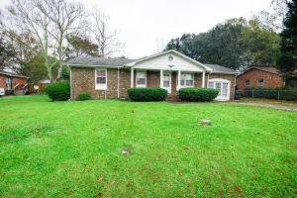
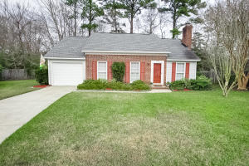
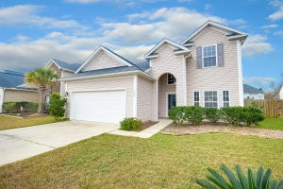
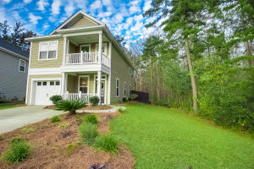
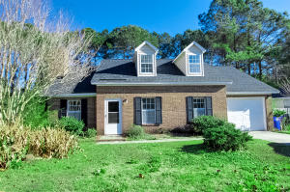
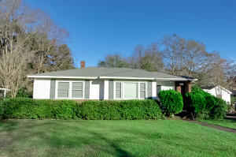
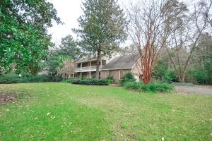
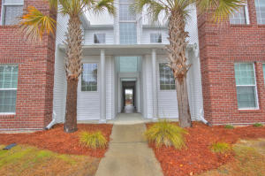
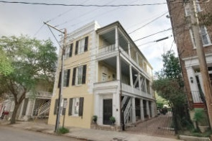
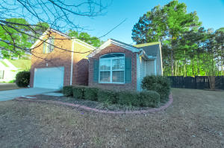
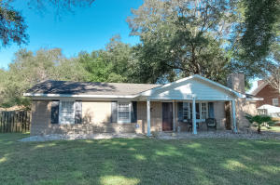
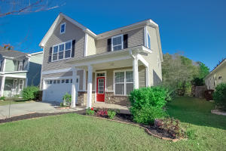
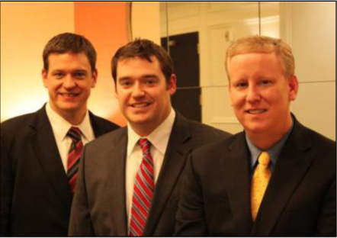

ChuckTown Homes New Listings!!
Cane Bay Plantation
Summerville
$209,900
MLS# 16000348
Eagle Harbor
Summerville
$300,000
MLS# 16001143
Park Circle
North Charleston
$189,900
MLS# 16000919
Under Contract
in 4 Days!
Click here to view listing
24-hour Information Hotline
888-210-3348 x2569
Click here to view listing
24-hour Information Hotline
888-210-3348 x3039
Click here to view listing
24-hour Information Hotline
888-210-3348 x2749
Under contract
in 3 days!
Glyn Terrace
North Charleston
$100,000
MLS# 16000159
Brandymill
Summerville
$134,900
MLS# 16000823
The Glen At Summerset
Summerville
$205,000
MLS# 16000466
Under Contract
in 3 Days!
Under Contract
in 11 Days!
Under Contract
in 11 Days!
Click here to view listing
24-hour Information Hotline
888-210-3348 x2789
Click here to view listing
24-hour Information Hotline
888-210-3348 x2409
Click here to view listing
24-hour Information Hotline
888-210-3348 x2709
Multiple Offers
in 4 Days!
Under Contract
in 4 Days!
Eagle Run
Ladson
$200,000
MLS# 16000445
Shadowmoss
Charleston
$200,000
MLS# 16000195
Memminger Hall
Charleston
$169,900
MLS# 16000235
Click here to view listing
24-hour Information Hotline
888-210-3348 x2929
Click here to view listing
24-hour Information Hotline
888-210-3348 x3749
Click here to view listing
24-hour Information Hotline
888-210-3348 x2949
Under Contract
in 17 Days!
Gadsen Manor
Summerville
$400,000
MLS# 15031683
Highlands of Legend
Summerville
$139,900
MLS# 15031078
Ansonborough
Charleston
$289,900
MLS# 15030636
Multiple offers in 24 Hours
Click here to view listing
24-hour Information Hotline
888-210-3348 x2199
Click here to view listing
24-hour Information Hotline
888-210-3348 x2029
Click here to view listing
24-hour Information Hotline
888-210-3348 x2099
Wescott Plantation
Summerville
$219,900
MLS# 15031006
Oakcrest
Charleston
$239,900
MLS# 16000137
Foxbank Plantation
Moncks Corner
$225,000
MLS# 16001211
Click here to view listing
24-hour Information Hotline
888-210-3348 x2479
Click here to view listing
24-hour Information Hotline
888-210-3348 x3149
Click here to view listing
24-hour Information Hotline
888-210-3348 x4059
Under Contract
in 8 Days!
ChuckTown Homes Real Estate
Owners:
Donald Russell, Jeremy Wilson, Shawn Pillion
Buyer Specialists:
Andrea Parler, Polly Cillpam, Ashley Towns,
Taylor Taylor, Steve Baller, & Luis Bordon
Phone: 888-210-3348
info@ChuckTownHomes.com
www.ChuckTownHomes.com

