Slide 1
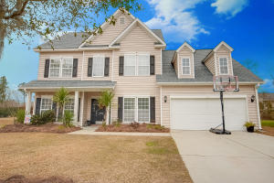
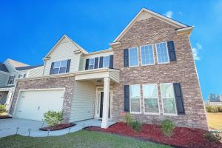
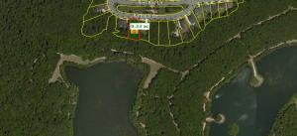
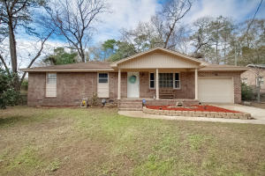
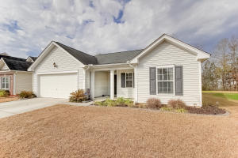
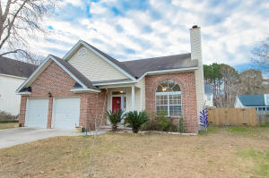
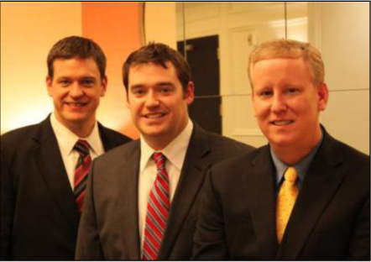

ChuckTown Homes New Listings!!
Wescott Plantation
Summerville
$279,900
MLS# 16002432
Carriage Lane
Summerville
$275,000
MLS# 16001474
Under Contract in 6 Days!
Click here to view listing
24-hour Information Hotline
888-210-3348 x2679
Click here to view listing
24-hour Information Hotline
888-210-3348 x2539
The Ponds
Summerville
$89,900
MLS# 16001473
Dorchester Estates
Summerville
$135,000
MLS# 16002062
Click here to view listing
24-hour Information Hotline
888-210-3348 x4109
Click here to view listing
24-hour Information Hotline
888-210-3348 x2609
Multiple Offers In First Week!
Under Contract in 7 Days!
Buckshire
Summerville
$164,900
MLS# 16002310
Westbourough
Charleston
$250,000
MLS# 16002252
Under Contract in 3 Days!
Under Contract in under 24 hours!
Click here to view listing
24-hour Information Hotline
888-210-3348 x2839
Click here to view listing
24-hour Information Hotline
888-210-3348 x2669
Multiple Offers In 2 Days!
ChuckTown Homes Real Estate
Owners:
Donald Russell, Jeremy Wilson, Shawn Pillion
Buyer Specialists:
Andrea Parler, Polly Cillpam, Ashley Towns, Taylor Taylor, Steve Baller, & Luis Bordon
Phone: 888-210-3348
info@ChuckTownHomes.com
www.ChuckTownHomes.com

