Slide 1
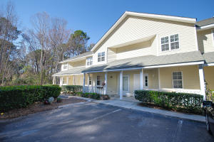
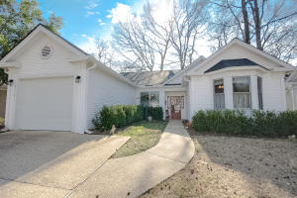
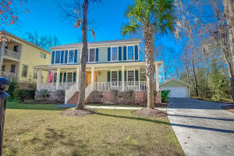
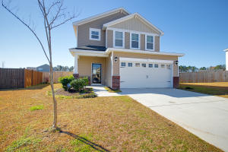
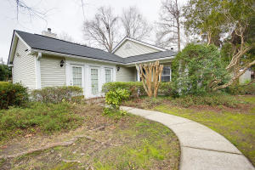
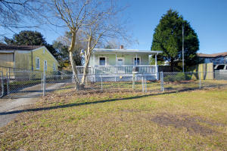
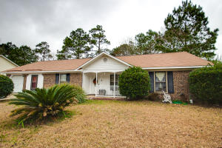
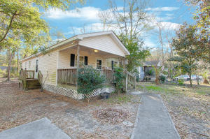
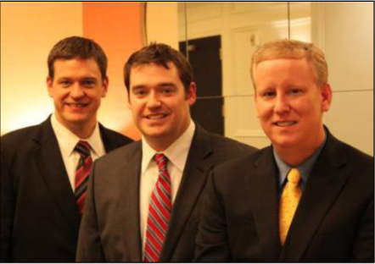

ChuckTown Homes New Listings!!
Riverland Place
James Island
$139,900
MLS# 16003340
The Elms of Charleston
North Charleston
$200,000
MLS# 16003387
Click here to view listing
24-hour Information Hotline
888-210-3348 x2219
Click here to view listing
24-hour Information Hotline
888-210-3348 x2189
Under Contract in 11 Days!
The Refuge at Whitehall
North Charleston
$500,000
MLS# 16002889
Liberty Hall
Goose Creek
$225,000
MLS# 16002698
Under Contract in 3 Days!
Click here to view listing
24-hour Information Hotline
888-210-3348 x4519
Click here to view listing
24-hour Information Hotline
888-210-3348 x3019
Under Contract in 11 Days!
Under Contract in 5 Days!
Shadowmoss Plantation
West Ashley
$200,000
MLS# 16002881
Waylyn
North Charleston
$50,000
MLS# 16003246
Click here to view listing
24-hour Information Hotline
888-210-3348 x2449
Click here to view listing
24-hour Information Hotline
888-210-3348 x3699
Under Contract in 7 Days!
Indian Spring
Summerville
$155,000
MLS# 16002990
Hobcaw Point
Mount Pleasant
$250,000
MLS# 16003528
Under Contract in 2 Days!
Under Contract in under 24 hours!
Click here to view listing
24-hour Information Hotline
888-210-3348 x2759
Click here to view listing
24-hour Information Hotline
888-210-3348 x2249
ChuckTown Homes Real Estate
Owners:
Donald Russell, Jeremy Wilson, Shawn Pillion
Buyer Specialists:
Andrea Parler, Polly Cillpam, Ashley Towns, Taylor Taylor, Steve Baller, & Luis Bordon
Phone: 888-210-3348
info@ChuckTownHomes.com
www.ChuckTownHomes.com

