Slide 1
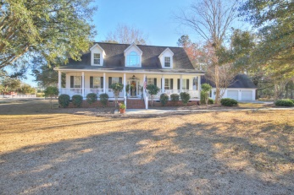
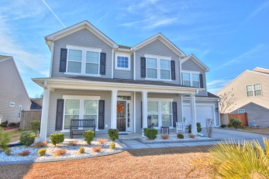
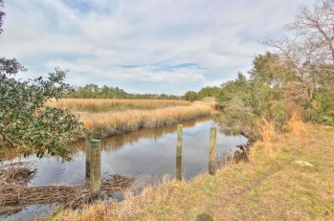
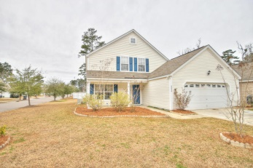
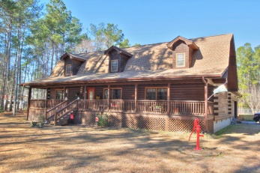
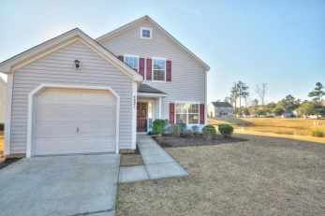
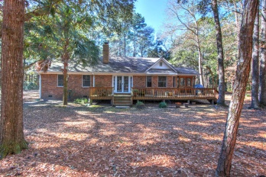
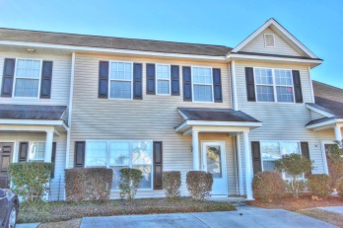
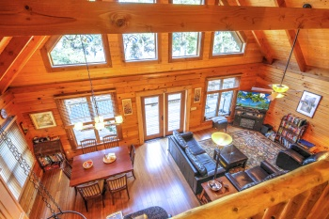
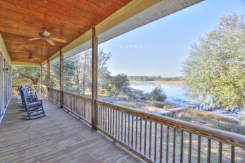
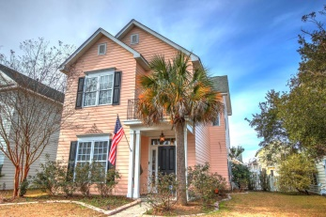
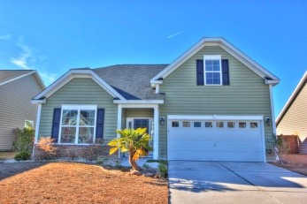
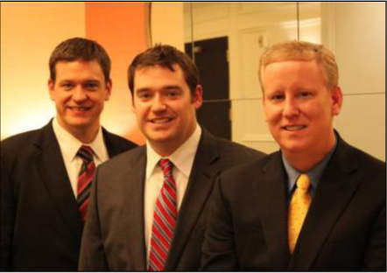

ChuckTown Homes New Listings!!
Under Contract in 6 Days!
Under Contract in 11 Days!
Under Contract in 11 Days!
Under Contract in 15 Days!
East Highland Acres
Summerville
$400,000
MLS# 15003720
Brickhope Plantation
Goose Creek
$275,000
MLS# 15003216
Parsonage Point
Charleston
$175,000
MLS# 15003056
Click here to view listing
24-hour Information Hotline
888-210-3348 x2839
Click here to view listing
24-hour Information Hotline
888-210-3348 x2779
Click here to view listing
24-hour Information Hotline
888-210-3348 x3659
The Farm at Wescott
Summerville
$179,900
MLS# 15003173
Summervale Acres
Summerville
$425,000
MLS# 15002904
The Farm at Wescott
Summerville
$175,000
MLS# 15002716
Click here to view listing
24-hour Information Hotline
888-210-3348 x2539
Click here to view listing
24-hour Information Hotline
888-210-3348 x2799
Click here to view listing
24-hour Information Hotline
888-210-3348 x2689
Middleton Plantation
Edisto Island
$339,900
MLS# 15002472
Lakes of Summerville
Summerville
$100,000
MLS# 15002560
Middleton Plantation
Edisto Island
$550,000
MLS# 15001947
Click here to view listing
24-hour Information Hotline
888-210-3348 x2629
Click here to view listing
24-hour Information Hotline
888-210-3348 x2129
Click here to view listing
24-hour Information Hotline
888-210-3348 x2649
Motega
Megget
$530,000
MLS# 15002909
White Gables
Summerville
$200,000
MLS# 15001688
Montague Plantation
Goose Creek
$215,000
MLS# 15001520
Click here to view listing
24-hour Information Hotline
888-210-3348 x2159
Click here to view listing
24-hour Information Hotline
888-210-3348 x3609
Click here to view listing
24-hour Information Hotline
888-210-3348 x3059
The ChuckTown Homes Team
Owners:
Donald Russell, Jeremy Wilson, Shawn Pillion
Buyers Specialists:
Andrea Parler, Tammie Phillips, Polly Cillpam, Ashley Towns, Katie McClure and Steve Baller
Phone: 888-210-3348
info@chucktownhomes.com
www.chucktownhomes.com

