Slide 1
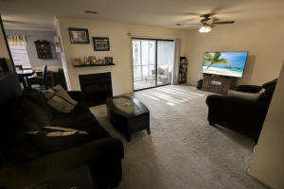
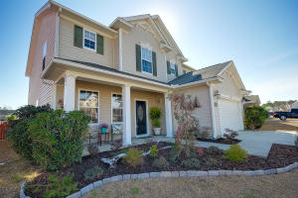
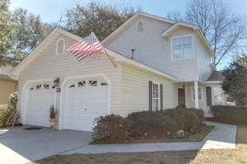
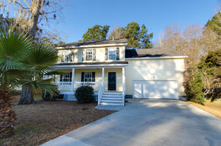
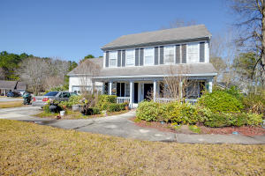
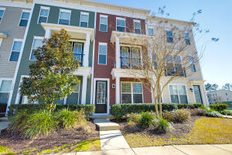
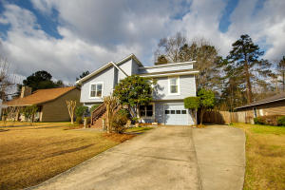
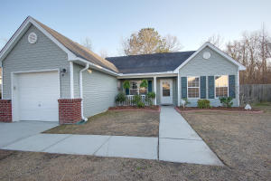
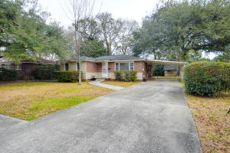
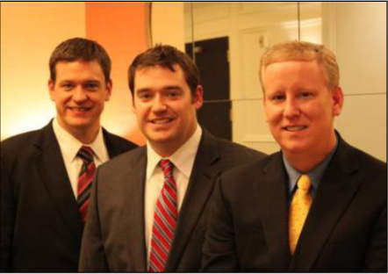

ChuckTown Homes New Listings!!
Greenlake Condominiums
Goose Creek
$69,000
MLS# 16004646
Foxbank Plantation
Moncks Corner
$216,000
MLS# 16004476
Shadowmoss Plantation
West Ashley
$215,000
MLS# 16004177
Click here to view listing
24-hour Information Hotline
888-210-3348 x2259
Click here to view listing
24-hour Information Hotline
888-210-3348 x4719
Click here to view listing
24-hour Information Hotline
888-210-3348 x2439
Under Contract
in 5 Days!
Under Contract
in 3 Days!
Hanahan Plantation
Hanahan
$205,000
MLS# 16003629
Summerville Place
Summerville
$115,000
MLS# 16004417
Bolton's Landing
West Ashley
$189,000
MLS# 16003499
Click here to view listing
24-hour Information Hotline
888-210-3348 x2779
Click here to view listing
24-hour Information Hotline
888-210-3348 x2689
Click here to view listing
24-hour Information Hotline
888-210-3348 x3569
Under Contract
in 6 Days!
Under Contract
in 2 Days!
Under Contract
in 5 Days!
Under Contract
in 5 Days!
Under Contract
in 7 Days!
Eagle Nest
North Charleston
$235,000
MLS# 16003839
Liberty Hall Plantation
Goose Creek
$175,000
MLS# 16004225
Cameron Terrace
North Charleston
$200,000
MLS# 16003835
Under Contract
in 2 Days!
Click here to view listing
24-hour Information Hotline
888-210-3348 x3609
Click here to view listing
24-hour Information Hotline
888-210-3348 x3059
Click here to view listing
24-hour Information Hotline
888-210-3348 x3659
Under Contract in under 24 hours!
Under Contract
in 3 Days!
ChuckTown Homes Real Estate
Owners:
Donald Russell, Jeremy Wilson, Shawn Pillion
Buyer Specialists:
Andrea Parler, Polly Cillpam, Ashley Towns,
Taylor Taylor, Steve Baller, & Luis Bordon
Phone: 888-210-3348
info@ChuckTownHomes.com
www.ChuckTownHomes.com

