Slide 1
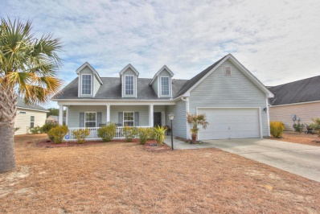
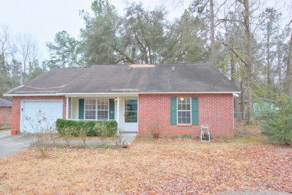
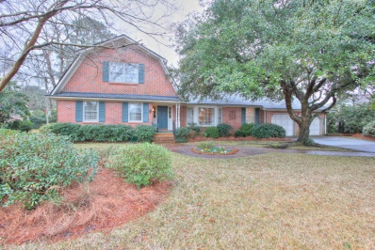
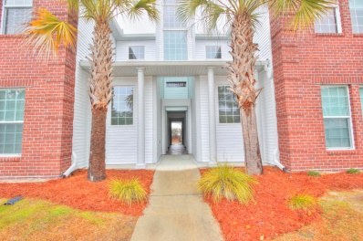
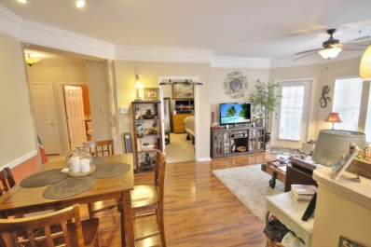
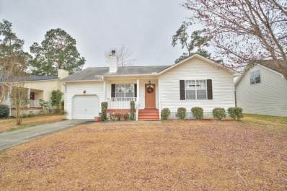
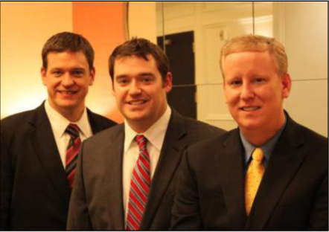

ChuckTown Homes New Listings!!
Under Contract in 11 Days!
Under Contract in 11 Days!
Under Contract in 15 Days!
Under Contract in 2 Days!
Summertrees
Johns Island
$225,000
MLS# 15004061
Berkeley Country Club
Moncks Corner
$135,000
MLS# 15004063
Click here to view listing
24-hour Information Hotline
888-210-3348 x2509
Click here to view listing
24-hour Information Hotline
888-210-3348 x3149
Under Contract in 4 Days!
Harrison Acres
Charleston
$325,000
MLS# 15004698
Legend Oaks Plantation
Summerville
$135,900
MLS# 15004878
Click here to view listing
24-hour Information Hotline
888-210-3348 x2199
Click here to view listing
24-hour Information Hotline
888-210-3348 x2029
Under Contract in 5 Days!
Mira Vista
Charleston
$200,000
MLS# 15005036
Indian Springs
Summerville
$145,000
MLS# 15005376
Click here to view listing
24-hour Information Hotline
888-210-3348 x3409
Click here to view listing
24-hour Information Hotline
888-210-3348 x2299
The ChuckTown Homes Team
Owners:
Donald Russell, Jeremy Wilson, Shawn Pillion
Buyers Specialists:
Andrea Parler, Tammie Phillips, Polly Cillpam, Ashley Towns, Katie McClure and Steve Baller
Phone: 888-210-3348
info@chucktownhomes.com
www.chucktownhomes.com

