Slide 1
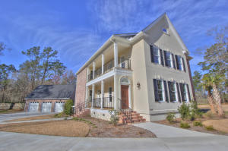
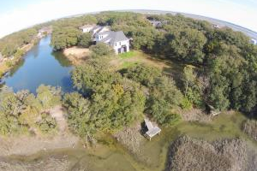
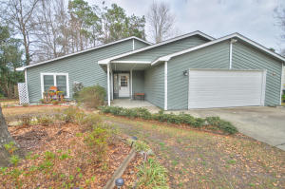
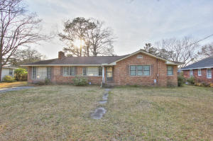
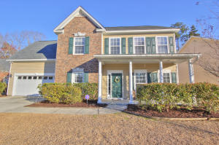
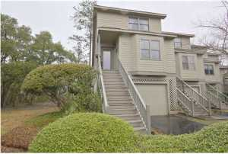
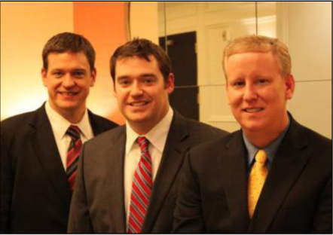

ChuckTown Homes New Listings!!
Under Contract in 11 Days!
Under Contract in 11 Days!
Under Contract in 15 Days!
Summerville
$550,000
MLS# 15006164
Cedar Point
Charleston
$225,000
MLS# 15005391
Click here to view listing
24-hour Information Hotline
888-210-3348 x3749
Click here to view listing
24-hour Information Hotline
888-210-3348 x3439
Under Contract in 8 Days!
Tramway Summerville
$179,900
MLS# 15005603
Under Contract in 1 Day!
Park Circle
North Charleston
$210,000
MLS# 15005777
Click here to view listing
24-hour Information Hotline
888-210-3348 x3789
Click here to view listing
24-hour Information Hotline
888-210-3348 x2929
Wescott Plantation
Summerville
$250,000
MLS# 15005791
Under Contract in 3 Days!
Waterway South
Charleston
$200,000
MLS# 15006228
Click here to view listing
24-hour Information Hotline
888-210-3348 x3689
Click here to view listing
24-hour Information Hotline
888-210-3348 x3449
The ChuckTown Homes Team
Owners:
Donald Russell, Jeremy Wilson, Shawn Pillion
Buyers Specialists:
Andrea Parler, Tammie Phillips, Polly Cillpam, Ashley Towns, Katie McClure and Steve Baller
Phone: 888-210-3348
info@chucktownhomes.com
www.chucktownhomes.com

