Slide 1
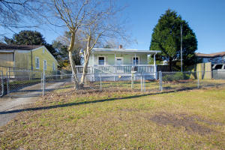
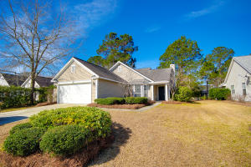
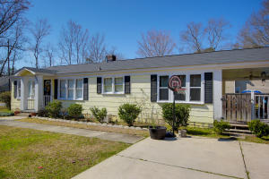
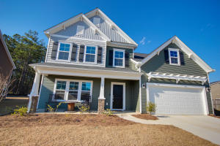
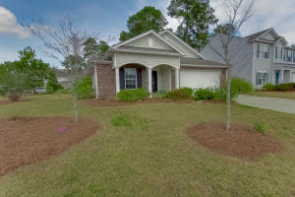
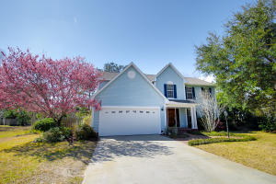
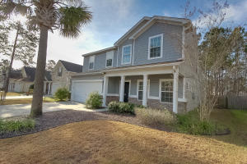
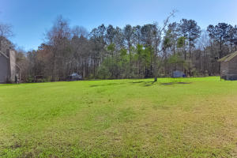
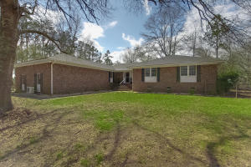
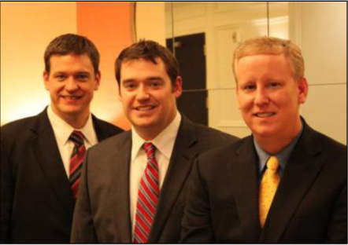

ChuckTown Homes New Listings!!
Waylan
N Charleston
$50,000
MLS# 16003246
Dunes West
Mt Pleasant
$289,900
MLS# 16005236
SHORT SALE Deer Park
N Charleston
$100,000
MLS# 16005305
Click here to view listing
24-hour Information Hotline
888-210-3348 x3699
Click here to view listing
24-hour Information Hotline
888-210-3348 x2869
Click here to view listing
24-hour Information Hotline
888-210-3348 x2329
Under Contract in 7 Days!
Under Contract in 23 Days!
Under Contract in 3 Days!
Spring Grove Plantation
Moncks Corner
$269,900
MLS# 16005406
Summer Park
Ladson
$189,900
MLS# 16005455
Crown Pointe
Mt Pleasant
$410,000
MLS# 16005646
Click here to view listing
24-hour Information Hotline
888-210-3348 x2699
Click here to view listing
24-hour Information Hotline
888-210-3348 x2919
Click here to view listing
24-hour Information Hotline
888-210-3348 x2529
Under Contract in 23 Days!
Under Contract in 10 Days!
Under Contract in 5 Days!
Under Contract in 7 Days!
Summer Park
Ladson
$250,000
MLS# 16006442
Lincolnville
Lincolnville
$35,000
MLS# 16006805
Cross
Cross
$384,900
MLS# 16006985
Under Contract in 2 Days!
Click here to view listing
24-hour Information Hotline
888-210-3348 x3759
Click here to view listing
24-hour Information Hotline
888-210-3348 x2429
Click here to view listing
24-hour Information Hotline
888-210-3348 x3689
Under Contract in under 24 hours!
Under Contract in 3 Days!
ChuckTown Homes Real Estate
Owners:
Donald Russell, Jeremy Wilson, Shawn Pillion
Buyer Specialists:
Andrea Parler, Polly Cillpam, Ashley Towns, Taylor Taylor, Daniel Bushby, & Luis Bordon
Phone: 888-210-3348
info@ChuckTownHomes.com
www.ChuckTownHomes.com

