Slide 1
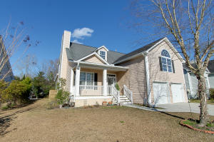
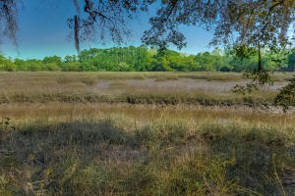
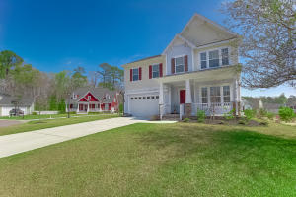
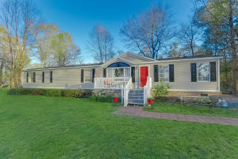
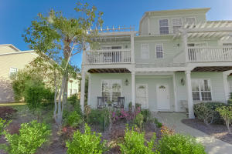
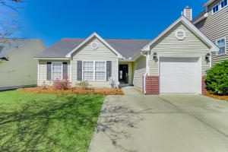
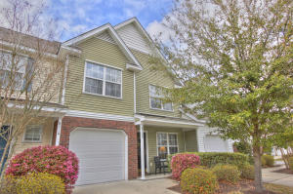
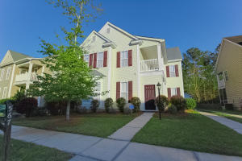
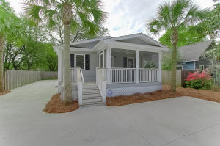
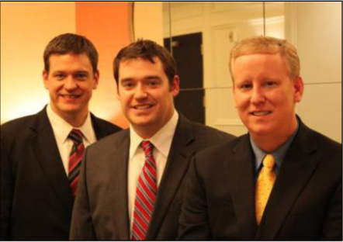

ChuckTown Homes New Listings!!
Stone Creek
West Ashley
$275,000
MLS# 16005132
Parish Point
Hollywood
$325,000
MLS# 16007113
Legend Oaks Plantation
Summerville
$375,000
MLS# 16007149
Click here to view listing
24-hour Information Hotline
888-210-3348 x2559
Click here to view listing
24-hour Information Hotline
888-210-3348 x3159
Click here to view listing
24-hour Information Hotline
888-210-3348 x2039
Under Contract
in 23 Days!
Under Contract
in 3 Days!
Under Contract
in 3 Days!
Cottageville
Cottageville
$129,900
MLS# 16007730
Whitney Lake
Johns Island
$229,900
MLS# 16007721
Weatherstone
Summerville
$145,000
MLS# 16007625
Click here to view listing
24-hour Information Hotline
888-210-3348 x2269
Click here to view listing
24-hour Information Hotline
888-210-3348 x2389
Click here to view listing
24-hour Information Hotline
888-210-3348 x2899
Under Contract
in 9 Days!
Under Contract
in 9 Days!
Under Contract
in 2 Days!
Under Contract
in 5 Days!
Under Contract
in 7 Days!
Coosaw Commons
N Charleston
$145,000
MLS# 16007936
Weatherstone
Summerville
$250,000
MLS# 16008376
Orange Grove Estates
West Ashley
$235,000
MLS# 16008426
Under Contract
in 2 Days!
Click here to view listing
24-hour Information Hotline
888-210-3348 x3639
Click here to view listing
24-hour Information Hotline
888-210-3348 x2719
Click here to view listing
24-hour Information Hotline
888-210-3348 x2129
Under Contract in under 24 hours!
Under Contract
in 3 Days!
ChuckTown Homes Real Estate
Owners:
Donald Russell, Jeremy Wilson, Shawn Pillion
Buyer Specialists:
Andrea Parler, Polly Cillpam, Ashley Towns,
Taylor Taylor, Daniel Bushby, & Luis Bordon
Phone: 888-210-3348
info@ChuckTownHomes.com
www.ChuckTownHomes.com

