Slide 1
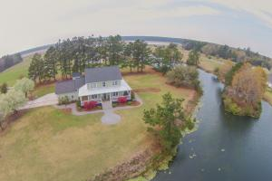
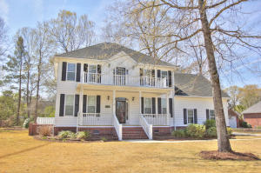
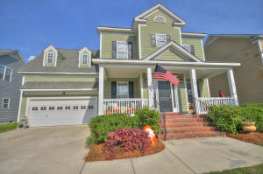
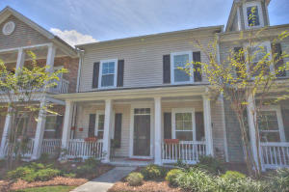
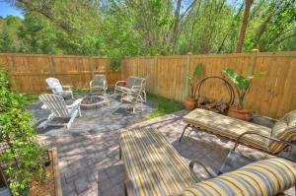
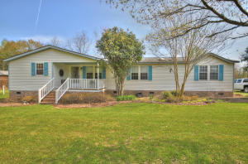
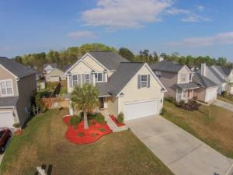
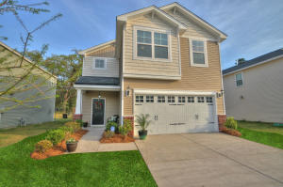
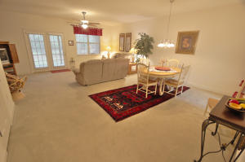
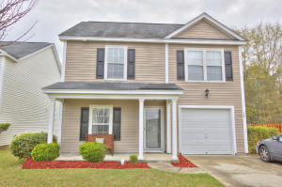
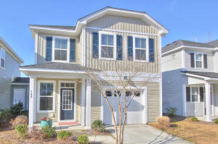
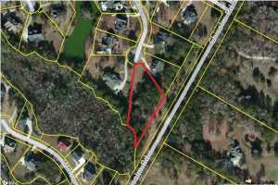
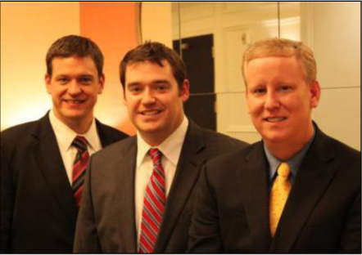

ChuckTown Homes New Listings!!
Under Contract in 6 Days!
Under Contract in 11 Days!
Under Contract in 15 Days!
Willow Lakes
Moncks Corner
$389,900
MLS# 15007090
Walnut Farms
Summerville
$350,000
MLS# 15006945
Legend Oaks Plantation
Summerville
$250,000
MLS# 15008967
Under Contract in 10 Days!
Under Contract in 20 Days!
Click here to view listing
24-hour Information Hotline
888-210-3348 x2789
Click here to view listing
24-hour Information Hotline
888-210-3348 x2579
Click here to view listing
24-hour Information Hotline
888-210-3348 x3139
Boltons Landing
Charleston
$225,000
MLS# 15008992
Ashley Park
Charleston
$184,900
MLS# 15008989
Saint George
Saint George
$239,900
MLS# 15008665
Click here to view listing
24-hour Information Hotline
888-210-3348 x2819
Click here to view listing
24-hour Information Hotline
888-210-3348 x2909
Click here to view listing
24-hour Information Hotline
888-210-3348 x2669
The Glen at Summerset
Summerville
$200,000
MLS# 15008561
Mckewn
Ladson
$184,900
MLS# 15008993
Ashley River Commons
North Charleston
$150,000
MLS# 15008318
Click here to view listing
24-hour Information Hotline
888-210-3348 x2919
Click here to view listing
24-hour Information Hotline
888-210-3348 x2619
Click here to view listing
24-hour Information Hotline
888-210-3348 x2899
Moss Grove Plantation
Moncks Corner
$139,900
MLS# 15007922
Grand Oaks Plantation
Charleston
$200,000
MLS# 15006420
Abbotts Glenn
Johns Island
$109,900
MLS# 15007308
Under Contract in 6 Days!
Under Contract in 20 Days!
Click here to view listing
24-hour Information Hotline
888-210-3348 x2479
Click here to view listing
24-hour Information Hotline
888-210-3348 x3759
Click here to view listing
24-hour Information Hotline
888-210-3348 x2419
The ChuckTown Homes Team
Owners:
Donald Russell, Jeremy Wilson, Shawn Pillion
Buyers Specialists:
Andrea Parler, Tammie Phillips, Polly Cillpam, Ashley Towns, Katie McClure and Steve Baller
Phone: 888-210-3348
info@chucktownhomes.com
www.chucktownhomes.com

