Slide 1
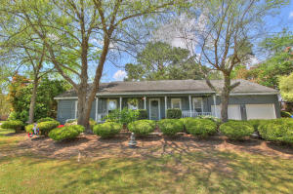
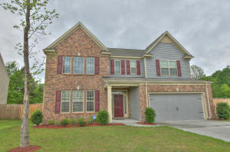
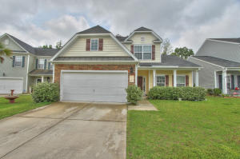
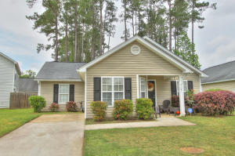

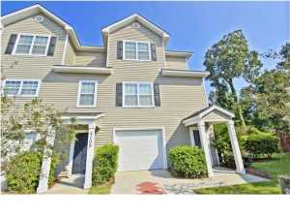
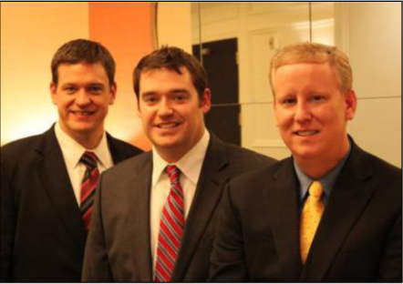

ChuckTown Homes New Listings!!
Under Contract in 11 Days!
Under Contract in 15 Days!
Harrison Acres
West Ashley
$335,000
MLS# 15009155
Carriage Lane
Summerville
$279,900
MLS# 15009850
Click here to view listing
24-hour Information Hotline
888-210-3348 x2609
Click here to view listing
24-hour Information Hotline
888-210-3348 x3759
Under Contract in 8 Days!
Under Contract in 1 Day!
Waterside Landing
Summerville
$200,000
MLS# 15009857
Bradford Chase
Summerville
$129,000
MLS# 15009686
Click here to view listing
24-hour Information Hotline
888-210-3348 x3069
Click here to view listing
24-hour Information Hotline
888-210-3348 x3619
Winnsboro Lakes
Johns Island
$175,000
MLS# 15009100
Ashley Park
West Ashley
$175,000
MLS# 15009284
Click here to view listing
24-hour Information Hotline
888-210-3348 x2889
Click here to view listing
24-hour Information Hotline
888-210-3348 x2979
Under Contract in 1 Day!
The ChuckTown Homes Team
Owners:
Donald Russell, Jeremy Wilson, Shawn Pillion
Buyers Specialists:
Andrea Parler, Tammie Phillips, Polly Cillpam, Ashley Towns, Taylor Taylor and Steve Baller
Phone: 888-210-3348
info@chucktownhomes.com
www.chucktownhomes.com

