Slide 1
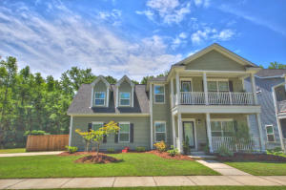
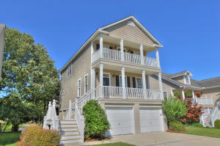
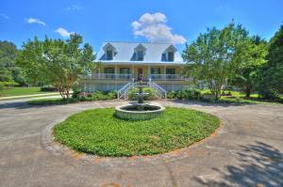
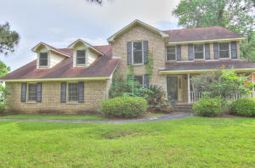
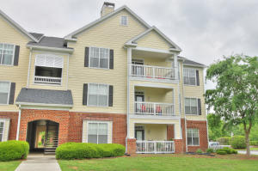
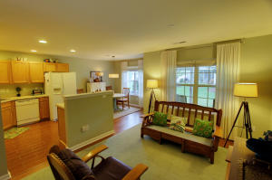
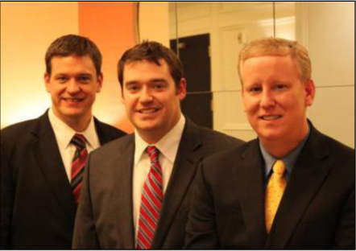

ChuckTown Homes New Listings!!
Swygerts Landing
Johns Island
$339,900
MLS# 15011038
Stone Creek
West Ashley
$275,000
MLS# 15010883
Click here to view listing
24-hour Information Hotline
888-210-3348 x3859
Click here to view listing
24-hour Information Hotline
888-210-3348 x2269
Under Contract in 5 Days!
Lems Bluff
Meggett
$800,000
MLS# 15011432
Kings Grant
Summerville
$275,000
MLS# 15011072
Click here to view listing
24-hour Information Hotline
888-210-3348 x3609
Click here to view listing
24-hour Information Hotline
888-210-3348 x2549
Concord West of the Ashley
West Ashley
$190,000
MLS# 15010385
Coosaw Commons
North Charleston
$129,900
MLS# 15010042
Click here to view listing
24-hour Information Hotline
888-210-3348 x2079
Click here to view listing
24-hour Information Hotline
888-210-3348 x2099
Under Contract in 8 Days!
The ChuckTown Homes Team
Owners:
Donald Russell, Jeremy Wilson, Shawn Pillion
Buyers Specialists:
Andrea Parler, Tammie Phillips, Polly Cillpam, Ashley Towns, Taylor Taylor and Steve Baller
Phone: 888-210-3348
info@chucktownhomes.com
www.chucktownhomes.com

