Slide 1
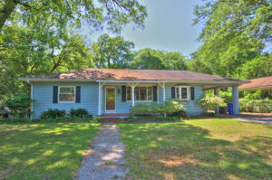
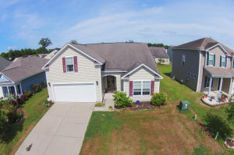
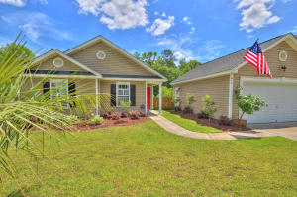
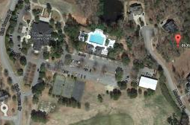
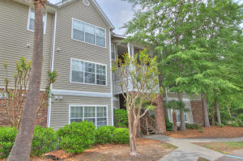
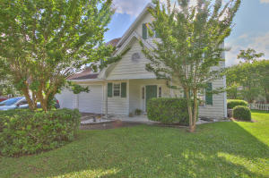
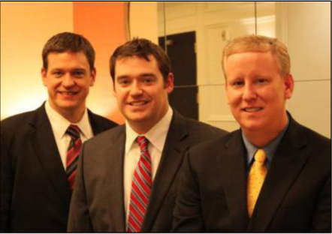

ChuckTown Homes New Listings!!
Laurel Park
Charleston
$245,000
MLS#15010872
Wescott Plantation
Summerville
$200,000
MLS#15011918
Click here to view listing
24-hour Information Hotline
888-210-3348 x3499
Click here to view listing
24-hour Information Hotline
888-210-3348 x2699
Lakes of Summerville
Summerville
$159,900
MLS#15011912
Coosaw Creek Country Club
North Charleston
$79,900
MLS#15011906
Click here to view listing
24-hour Information Hotline
888-210-3348 x2209
Click here to view listing
24-hour Information Hotline
888-210-3348 x3269
Under Contract in less than 24 hours!
Midland Terrace
Summerville
$119,900
MLS#15011923
Riverchase
North Charleston
$159,900
MLS#15011522
Under Contract
in 8 Days!
Click here to view listing
24-hour Information Hotline
888-210-3348 x3279
Click here to view listing
24-hour Information Hotline
888-210-3348 x3299
The ChuckTown Homes Team
Owners:
Donald Russell, Jeremy Wilson, Shawn Pillion
Buyers Specialists:
Andrea Parler, Tammie Phillips, Polly Cillpam,
Ashley Towns, Taylor Taylor and Steve Baller
Phone: 888-210-3348
info@chucktownhomes.com
www.chucktownhomes.com

