Slide 1
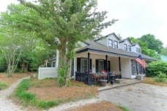
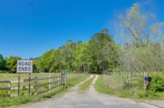
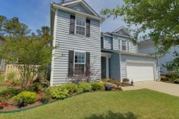
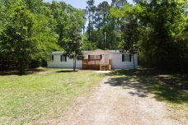
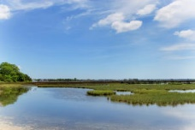
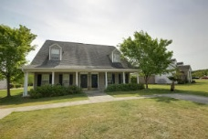
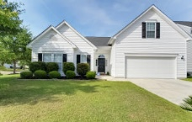
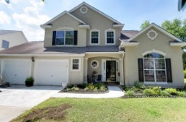
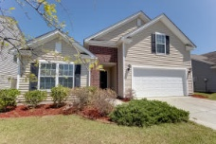
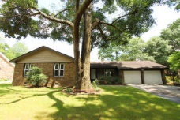
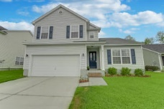
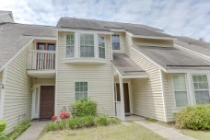
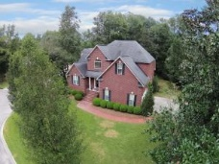
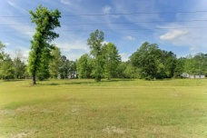
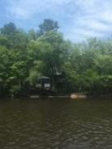
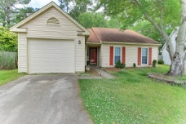
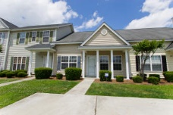
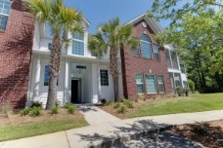
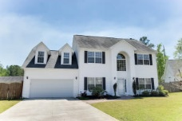
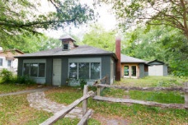
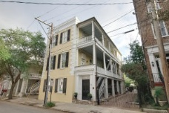
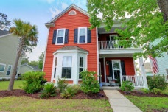
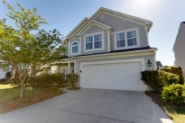
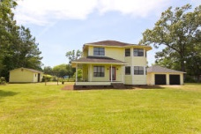
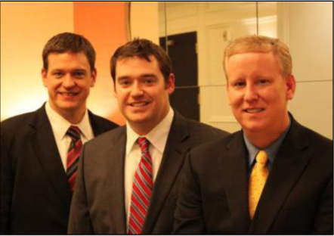

ChuckTown Homes New Listings!!
Fox Pond
Mount Pleasant
$389,900
MLS# 16011722
Coral Acres
Moncks Corner
$55,000
MLS# 16009514
Wentworth Hall
Summerville
$300,000
MLS# 16010550
Summerville
Almost ½ acre
$94,900
MLS# 16011741
Under Contract in 4 Days!
Click here to view listing
24-hour Information Hotline
888-210-3348 x2839
Click here to view listing
24-hour Information Hotline
888-210-3348 x3619
Click here to view listing
24-hour Information Hotline
888-210-3348 x2949
Click here to view listing
24-hour Information Hotline
888-210-3348 x2609
Rushland Plantation
Johns Island
$400,000
MLS# 16011040
Dunes West
Mount Pleasant
$215,000
MLS# 16010538
Westcott Plantation
Summerville
$225,000
MLS# 16011066
Whitehall
North Charleston
$219,900
MLS# 16011111
Click here to view listing
24-hour Information Hotline
888-210-3348 x4609
Click here to view listing
24-hour Information Hotline
888-210-3348 x2989
Under contract in 24 Hours!
Under contract in 6 Days!
Click here to view listing
24-hour Information Hotline
888-210-3348 x3299
Click here to view listing
24-hour Information Hotline
888-210-3348 x3319
Brickhope Plantation
Goose Creek
$200,000
MLS# 16010522
Dominion Hills
Hanahan
$200,000
MLS# 16011920
Wescott Plantation
Summerville
$235,500
MLS# 16008855
Lakeside
Charleston
$189,900
MLS# 16010015
Under contract in 4 Days!
Under contract in 3 Days!
Under contract in 6 Days!
Click here to view listing
24-hour Information Hotline
888-210-3348 x3149
Click here to view listing
24-hour Information Hotline
888-210-3348 x2959
Click here to view listing
24-hour Information Hotline
888-210-3348 x3729
Click here to view listing
24-hour Information Hotline
888-210-3348 x3719
Bakers Landing
North Charleston
$335,000
MLS# 16011045
Durham Landing
Moncks Corner
$125,000
MLS# 16011147
Ridgeville
On the Edisto, deep water
$250,000
MLS# 16012451
Crowfield Plantation
Goose Creek
$134,900
MLS# 16012196
Under Contract in 17 Days!
Under contract in 8 Days!
Click here to view listing
24-hour Information Hotline
888-210-3348 x2579
Click here to view listing
24-hour Information Hotline
888-210-3348 x2289
Click here to view listing
24-hour Information Hotline
888-210-3348 x3379
Click here to view listing
24-hour Information Hotline
888-210-3348 x3499
Lakes of Summerville
Summerville
$109,900
MLS# 16011889
Legend Oaks Plantation
Summerville
$145,000
MLS# 16009558
Spring Grove Plantation
Moncks Corner
$214900
MLS# 16010426
Ardmore
Charleston
$139,900
MLS# 16011320
Multiple offers in 24 Hours
Click here to view listing
24-hour Information Hotline
888-210-3348 x3749
Click here to view listing
24-hour Information Hotline
888-210-3348 x2459
Under contract in 12 Days!
Multiple Offers
Click here to view listing
24-hour Information Hotline
888-210-3348 x3649
Click here to view listing
24-hour Information Hotline
888-210-3348 x2479
Multiple Offers
Ansonborough
Charleston
$309,900
MLS# 16008343
Carolina Bay
West Ashley
$342,900
MLS# 16011702
The Glen at Summerset
Summerville
$200,000
MLS# 16010675
Yonges Island
Hollywood
$175,000
MLS# 16012524
Under Contract in 8 Days!
Click here to view listing
24-hour Information Hotline
888-210-3348 x2489
Click here to view listing
24-hour Information Hotline
888-210-3348 x2869
Under contract in 4 Days!
Click here to view listing
24-hour Information Hotline
888-210-3348 x2789
Click here to view listing
24-hour Information Hotline
888-210-3348 x2999
ChuckTown Homes Real Estate
Owners:
Donald Russell, Jeremy Wilson, Shawn Pillion
Buyer Specialists:
Andrea Parler, Polly Cillpam, Ashley Towns, Taylor Taylor, Steve Baller, & Luis Bordon
Phone: 888-210-3348
info@ChuckTownHomes.com
www.ChuckTownHomes.com

