Slide 1
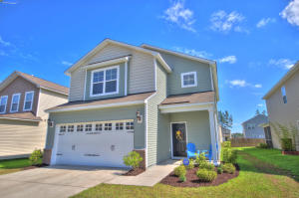
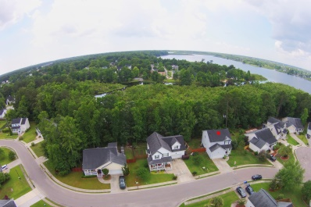
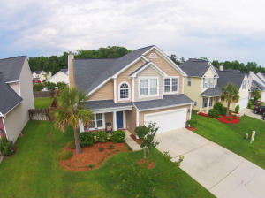
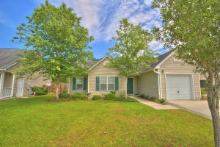
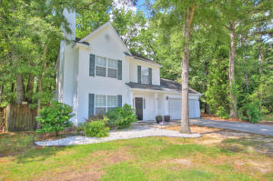
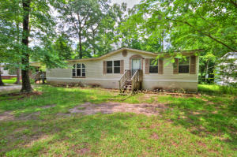
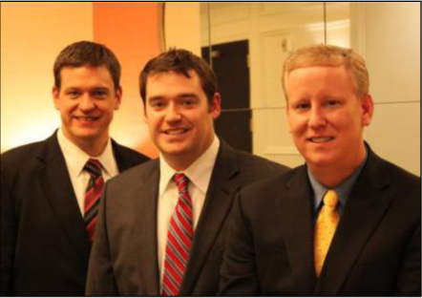

ChuckTown Homes New Listings!!
Cane Bay Plantation
Summerville
$200,000
MLS# 15013856
Hanahan Plantation
Hanahan
$225,000
MLS# 15012587
Click here to view listing
24-hour Information Hotline
888-210-3348 x2779
Click here to view listing
24-hour Information Hotline
888-210-3348 x3019
The Glen at Summerset
Summerville
$184,900
MLS# 15012738
Weatherstone
Summerville
$169,900
MLS# 15013840
Under Contract in less than 24 hours!
Click here to view listing
24-hour Information Hotline
888-210-3348 x2439
Click here to view listing
24-hour Information Hotline
888-210-3348 x2419
Under Contract
in 3 Days!
Boulder Bluff
Goose Creek
$150,000
MLS# 15008159
Pinehill Acres
Summerville
$87,500
MLS# 15012921
Click here to view listing
24-hour Information Hotline
888-210-3348 x2289
Click here to view listing
24-hour Information Hotline
888-210-3348 x2139
The ChuckTown Homes Team
Owners:
Donald Russell, Jeremy Wilson, Shawn Pillion
Buyers Specialists:
Andrea Parler, Tammie Phillips, Polly Cillpam,
Ashley Towns, Taylor Taylor and Steve Baller
Phone: 888-210-3348
info@chucktownhomes.com
www.chucktownhomes.com

