Slide 1
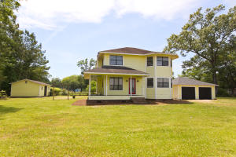
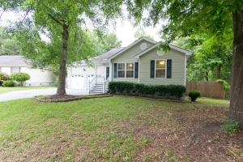
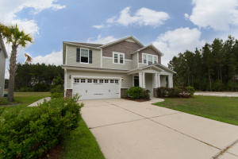
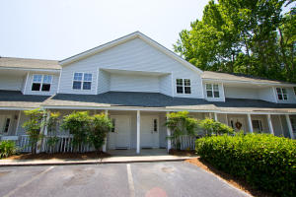
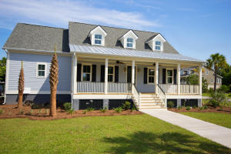
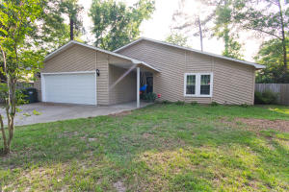
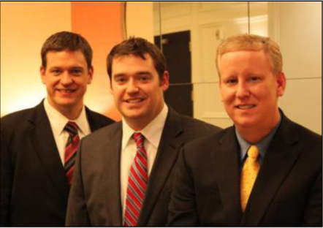

ChuckTown Homes New Listings!!
Yonges Island
Hollywood
$175,000
MLS# 16012524
Canterbury Woods
Charleston
$195,000
MLS# 16013565
Under Contract
in 6 Days!
Click here to view listing
24-hour Information Hotline
888-210-3348 x2999
Click here to view listing
24-hour Information Hotline
888-210-3348 x2339
Under Contract
in 16 Days
Under Contract
in 2 Days
Cane Bay Plantation
Summerville
$235,000
MLS# 16013447
Riverland Place
Charleston
$135,000
MLS# 16013918
Click here to view listing
24-hour Information Hotline
888-210-3348 x2779
Click here to view listing
24-hour Information Hotline
888-210-3348 x2219
Under Contract
in 8 Days
Under Contract
in 7 Days!
Grimball Gates
Johns Island
$609,900
MLS# 16014111
Tramway
Summerville
$185,000
MLS# 16014222
Under Contract
in 3 Days!
Under Contract in under 24 hours!
Click here to view listing
24-hour Information Hotline
888-210-3348 x4259
Click here to view listing
24-hour Information Hotline
888-210-3348 x2929
ChuckTown Homes Real Estate
Owners:
Donald Russell, Jeremy Wilson, Shawn Pillion
Buyer Specialists:
Andrea Parler, Polly Cillpam, Ashley Towns,
Taylor Taylor, Daniel Bushby, Scott Plumer & Luis Bordon
Phone: 888-210-3348
info@ChuckTownHomes.com
www.ChuckTownHomes.com

