Slide 1
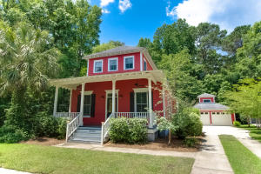
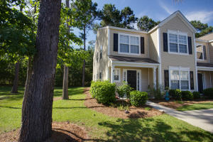
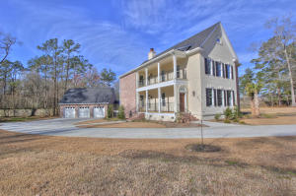
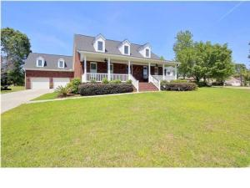
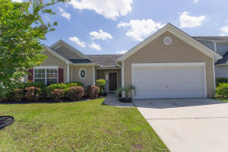
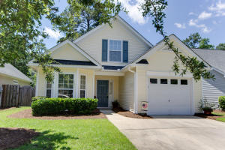
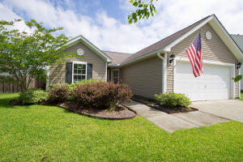
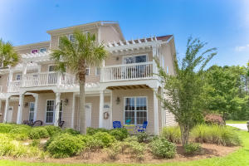
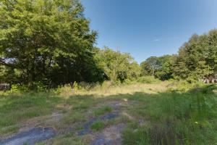
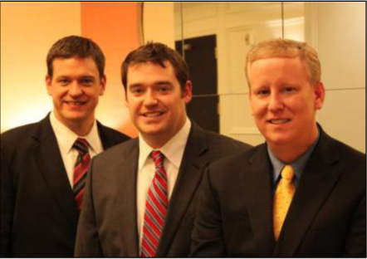

ChuckTown Homes New Listings!!
The Villages in St Johns Woods
Johns Island
$425,000
MLS# 16014864
Wescott Plantation
Summerville
$150,000
MLS# 16015565
Custom Built
Summerville
$525,000
MLS# 16015552
Click here to view listing
24-hour Information Hotline
888-210-3348 x2109
Click here to view listing
24-hour Information Hotline
888-210-3348 x2769
Click here to view listing
24-hour Information Hotline
888-210-3348 x2659
Under Contract in 2 Days
The Hamlets
Goose Creek
$479,900
MLS# 16015511
Berkeley Commons
Summerville
$159,900
MLS# 16015462
Wescott Plantation
Summerville
$165,000
MLS# 16015456
Click here to view listing
24-hour Information Hotline
888-210-3348 x3659
Click here to view listing
24-hour Information Hotline
888-210-3348 x2629
Click here to view listing
24-hour Information Hotline
888-210-3348 x3449
Under Contract in 1 Day!
Under Contract in 7 Days!
Wescott Plantation
Summerville
$175,000
MLS# 16015434
Whitney Lake
Johns Island
$229,900
MLS# 16015273
Dupont
West Ashley
$300,000
MLS# 16015199
Under Contract in 3 Days!
Under Contract in under 24 hours!
Click here to view listing
24-hour Information Hotline
888-210-3348 x3019
Click here to view listing
24-hour Information Hotline
888-210-3348 x3459
Click here to view listing
24-hour Information Hotline
888-210-3348 x2899
Under Contract in 1 Day!
Under Contract in 6 Days!
ChuckTown Homes Real Estate
Owners:
Donald Russell, Jeremy Wilson, Shawn Pillion
Buyer Specialists:
Andrea Parler, Polly Cillpam, Ashley Towns, Taylor Taylor, Daniel Bushby, Scott Plumer & Luis Bordon
Phone: 888-210-3348
info@ChuckTownHomes.com
www.ChuckTownHomes.com

