Slide 1
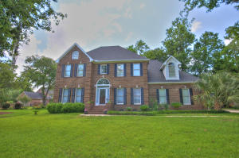
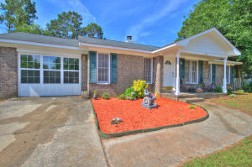
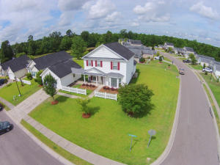
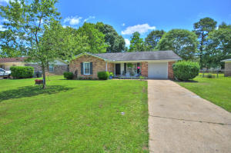
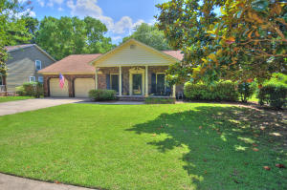
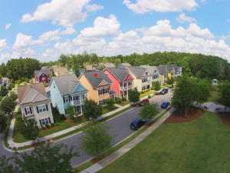
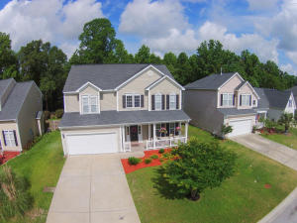
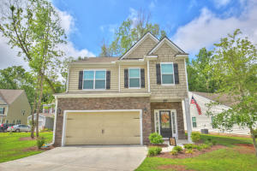
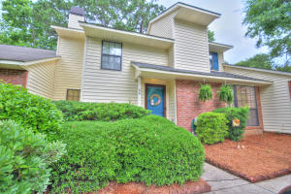
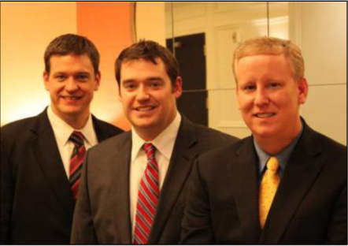

ChuckTown Homes New Listings!!
Under Contract
in 6 Days!
Under Contract
in 11 Days!
Under Contract
in 11 Days!
Under Contract
in 15 Days!
Maclaura Hall
Charleston
$375,000
MLS# 15015336
Crestwood
Summerville
$136,900
MLS# 15015406
The Lakes of Summerville
Summerville
$184,900
MLS# 15015460
Click here to view listing
24-hour Information Hotline
888-210-3348 x2529
Click here to view listing
24-hour Information Hotline
888-210-3348 x2959
Click here to view listing
24-hour Information Hotline
888-210-3348 x2829
Sangaree
Summerville
$139,900
MLS# 15015875
Ashley Hall Plantation
Charleston
$275,000
MLS# 15015905
The Ponds
Summerville
$255,000
MLS# 15015993
Click here to view listing
24-hour Information Hotline
888-210-3348 x2369
Click here to view listing
24-hour Information Hotline
888-210-3348 x2569
Click here to view listing
24-hour Information Hotline
888-210-3348 x4109
Under Contract
in 3 Days!
Under Contract
in 2 Days!
Plum Creek
Summerville
$225,000
MLS# 15014654
Hickory Ridge
Summerville
$230,000
MLS# 15015291
Crowfield Plantation
Goose Creek
$125,000
MLS# 15014777
Click here to view listing
24-hour Information Hotline
888-210-3348 x3649
Click here to view listing
24-hour Information Hotline
888-210-3348 x2309
Click here to view listing
24-hour Information Hotline
888-210-3348 x2129
Under Contract
in 7 Days!
Under Contract in under 24 hours!
The ChuckTown Homes Team
Owners:
Donald Russell, Jeremy Wilson, Shawn Pillion
Buyers Specialists:
Andrea Parler, Tammie Phillips, Polly Cillpam,
Ashley Towns, Taylor Taylor, Steve Baller, & Luis Bordon
Phone: 888-210-3348
info@chucktownhomes.com
www.chucktownhomes.com

