Slide 1
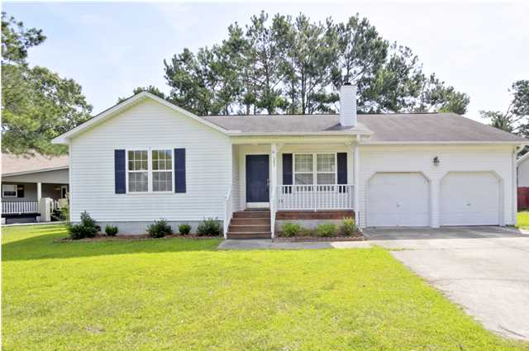
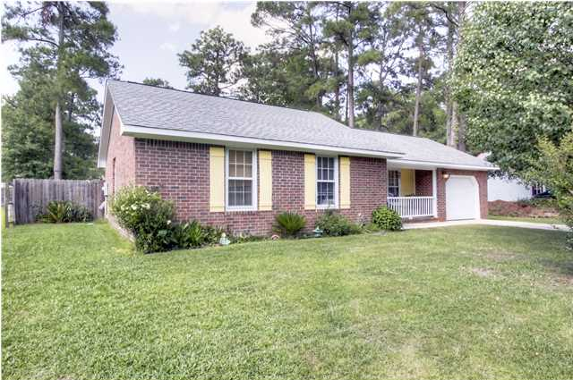
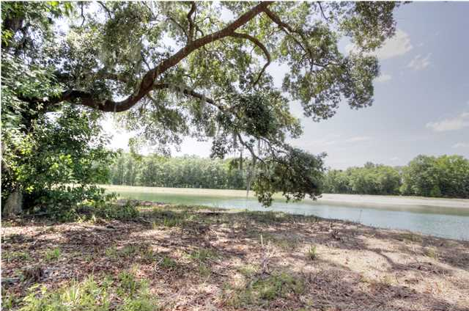
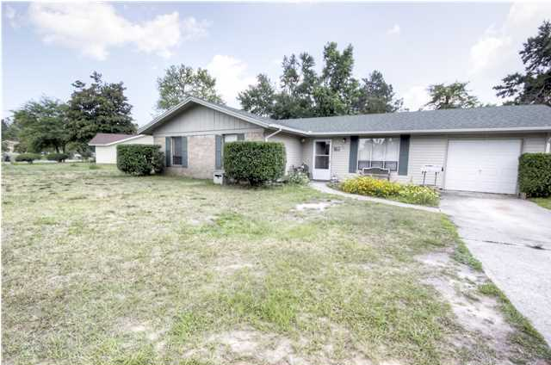
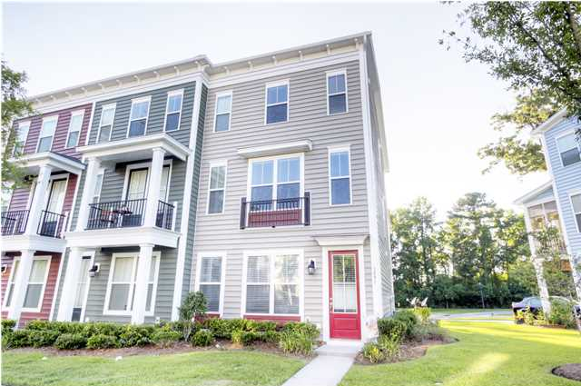
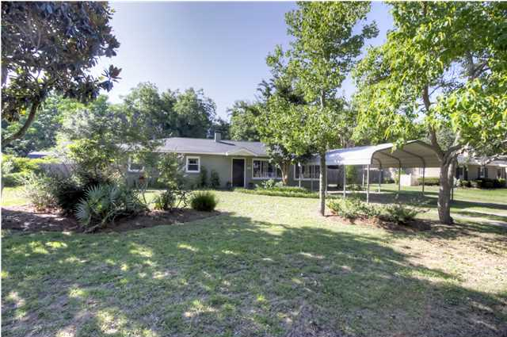
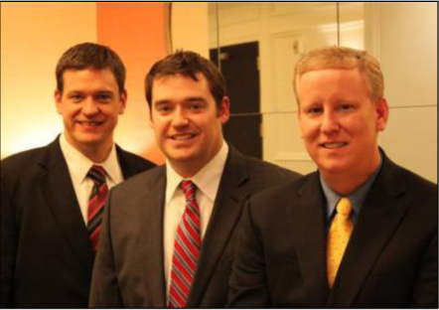

ChuckTown Homes New Listings!!
Marlin Estates
Summerville
$144,900
MLS# 1415552
Millwood
Summerville
$129,900
MLS# 1415844
Click here to view listing
24-hour Information Hotline
888-210-3348 x2679
Click here to view listing
24-hour Information Hotline
888-210-3348 x3129
Adams Run
Adams Run
$175,000
MLS# 1415837
Conifer Hall
Moncks Corner
$109,900
MLS# 1416618
Click here to view listing
24-hour Information Hotline
888-210-3348 x2289
Click here to view listing
24-hour Information Hotline
888-210-3348 x2899
Bolton's Landing
Charleston
$200,000
MLS# 1416623
Secessionville
Charleston
$239,900
MLS# 1416756
Click here to view listing
24-hour Information Hotline
888-210-3348 x2919
Click here to view listing
24-hour Information Hotline
888-210-3348 x2909
The ChuckTown Homes Team
Owners:
Donald Russell, Jeremy Wilson, Shawn Pillion
Buyers Specialists:
Andrea Parler, Megan Tice, Tammie Phillips,
Cayce Hennessee, Polly Cillpam
Phone: 888-210-3348
info@chucktownhomes.com
www.chucktownhomes.com

