Slide 1
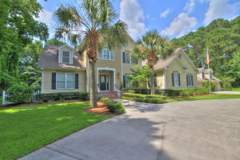
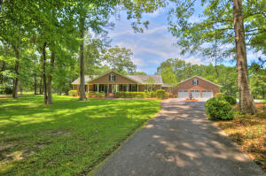
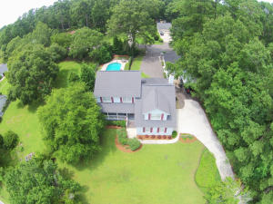
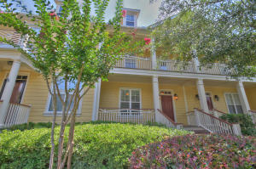
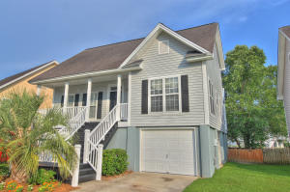
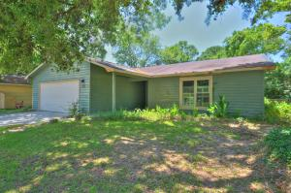
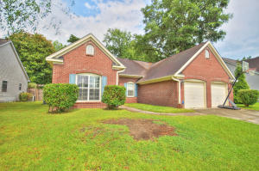
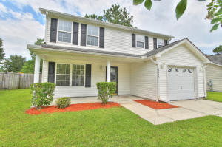
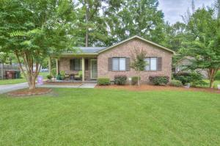
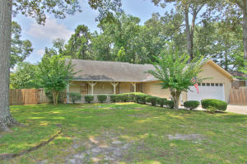
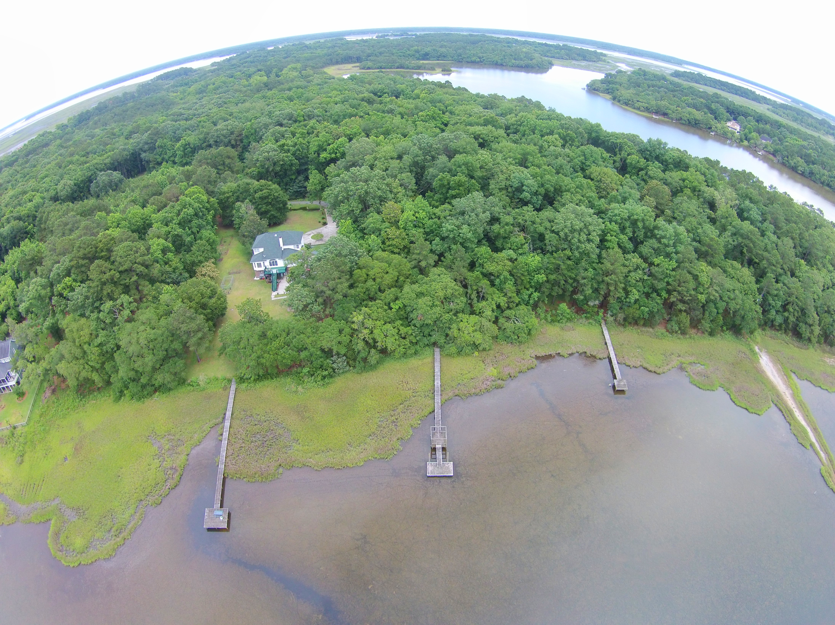
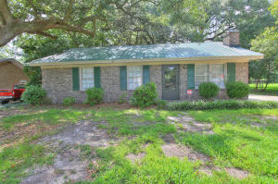
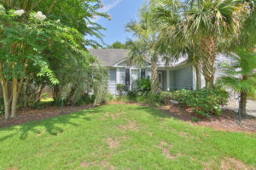
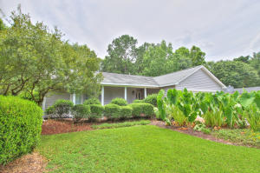
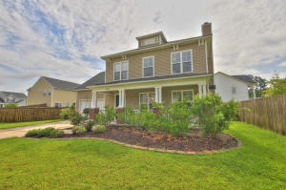
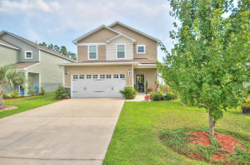
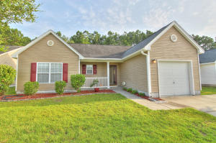
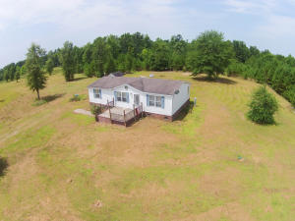
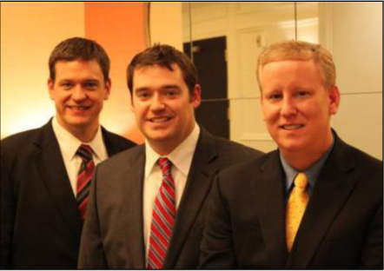

ChuckTown Homes Real Estate New Listings
Shoreline Farms
Johns Island
$649,900
MLS# 15018334
Hickory Farms
West Ashley
$600,000
MLS# 15017445
Orchard Hill
Summerville
$289,900
MLS# 15018326
Under Contract in 6 Days!
Under Contract in 11 Days!
Under Contract in 11 Days!
Under Contract in 15 Days!
Click here to view listing
24-hour Information Hotline
888-210-3348 x.2279
Click here to view listing
24-hour Information Hotline
888-210-3348 x.3699
Click here to view listing
24-hour Information Hotline
888-210-3348 x.2949
Hamlin Plantation
Mount Pleasant
$239,900
MLS# 15017873
Stone Creek
West Ashley
$275,000
MLS# 15016538
Coopers Landing
Mount Pleasant
$200,000
MLS# 15016486
Click here to view listing
24-hour Information Hotline
888-210-3348 x.2169
Click here to view listing
24-hour Information Hotline
888-210-3348 x.3709
Click here to view listing
24-hour Information Hotline
888-210-3348 x.3779
Whitehall
North Charleston
$175,000
MLS# 15017213
Heaton Place
Ladson
$159,500
MLS# 15017948
Hillcrest Farms
Moncks Corner
$119,900
MLS# 15018051
Click here to view listing
24-hour Information Hotline
888-210-3348 x.2979
Click here to view listing
24-hour Information Hotline
888-210-3348 x.2339
Click here to view listing
24-hour Information Hotline
888-210-3348 x.2849
Quail Arbor V
Summerville
$219,900
MLS# 15017401
Yonges Island
Meggett
$144,900
MLS# 15017338
Boulder Bluff
Goose Creek
$100,000
MLS# 15018304
Click here to view listing
24-hour Information Hotline
888-210-3348 x.2719
Click here to view listing
24-hour Information Hotline
888-210-3348 x.2349
Click here to view listing
24-hour Information Hotline
888-210-3348 x.3679
Summerville Place
Summerville
$169,900
MLS# 15018327
Forest Lakes Extension
West Ashley
$215,000
MLS# 15017310
Brickhope Greens
Goose Creek
$200,000
MLS# 15017767
Click here to view listing
24-hour Information Hotline
888-210-3348 x.2449
Click here to view listing
24-hour Information Hotline
888-210-3348 x.2409
Click here to view listing
24-hour Information Hotline
888-210-3348 x.2069
Cane Bay Plantation
Summerville
$215,000
MLS# 15016659
Weatherstone
Summerville
$139,900
MLS# 15018191
Pineville
$100,000
MLS# 15018242
Click here to view listing
24-hour Information Hotline
888-210-3348 x.3739
Click here to view listing
24-hour Information Hotline
888-210-3348 x.2659
Click here to view listing
24-hour Information Hotline
888-210-3348 x.2739
ChuckTown Homes Real Estate
Owners:
Donald Russell, Jeremy Wilson, Shawn Pillion
Buyer Specialists:
Andrea Parler, Tammie Phillips, Polly Cillpam, Ashley Towns, Taylor Taylor, Steve Baller, & Luis Bordon
Phone: 888-210-3348
info@ChuckTownHomes.com
www.ChuckTownHomes.com

