Slide 1
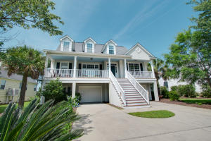
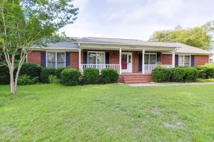
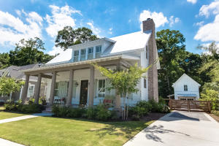
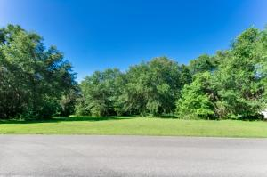
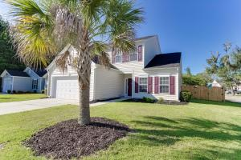
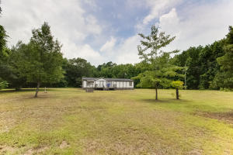
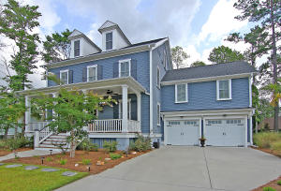
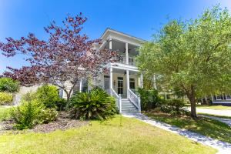
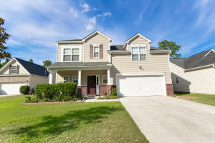
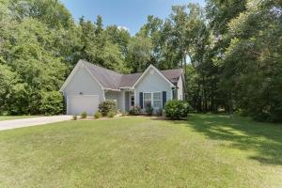
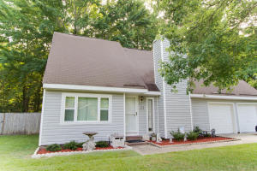
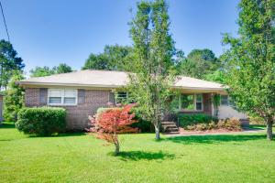
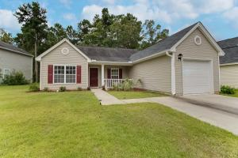
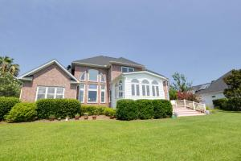
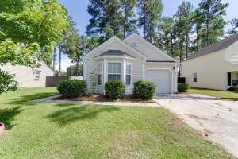
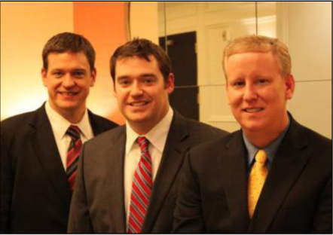

ChuckTown Homes New Listings!!
Rivertowne - Carolina Isle
Mount Pleasant
$600,000
MLS# 16016800
South Pointe
Summerville
$200,000
MLS# 16017391
The Villages in St Johns Woods
Johns Island
$650,000
MLS# 16018051
Under Contract in 4 Days!
Click here to view listing
24-hour Information Hotline
888-210-3348 x4809
Click here to view listing
24-hour Information Hotline
888-210-3348 x2799
Click here to view listing
24-hour Information Hotline
888-210-3348 x3389
Under contract in less than a week!
Gift Plantation
Johns Island
$175,000
MLS# 16016589
Waterside Landing
Summerville
$205,000
MLS# 16017984
Almost 7 Acres
Ravenel
$75,000
MLS# 16017469
Under Contract in 3 Days!
Under Contract in 11 Days!
Under Contract in 11 Days!
Click here to view listing
24-hour Information Hotline
888-210-3348 x2529
Click here to view listing
24-hour Information Hotline
888-210-3348 x3779
Click here to view listing
24-hour Information Hotline
888-210-3348 x2759
Under Contract in 3 Days!
Multiple offers in less than a week!
Riverside - Carolina Park
Mount Pleasant
$650,000
MLS# 16018091
The Villages in St Johns Woods
Johns Island
$450,000
MLS# 16015916
Buckshire
Summerville
$200,000
MLS# 16017379
Click here to view listing
24-hour Information Hotline
888-210-3348 x5109
Click here to view listing
24-hour Information Hotline
888-210-3348 x4409
Click here to view listing
24-hour Information Hotline
888-210-3348 x2539
Under contract in 48 hours!
White Church Place
Summerville
$175,000
MLS# 16018144
Crowfield Plantation
Goose Creek
$165,000
MLS# 16017301
Springfield
West Ashley
$219,900
MLS# 16016817
Click here to view listing
24-hour Information Hotline
888-210-3348 x2449
Click here to view listing
24-hour Information Hotline
888-210-3348 x2439
Click here to view listing
24-hour Information Hotline
888-210-3348 x2919
Under contract in 4 days!
Summer Park
Ladson
$155,000
MLS# 16018540
Hidden Lakes
Mount Pleasant
$900,000
MLS# 16018569
Wescott Plantation - The Farm
Summerville
$159,900
MLS# 16018530
Click here to view listing
24-hour Information Hotline
888-210-3348 x2419
Click here to view listing
24-hour Information Hotline
888-210-3348 x3739
Click here to view listing
24-hour Information Hotline
888-210-3348 x3669
Under Contract in 3 Days!
Under contract in 24 hours!
ChuckTown Homes Real Estate
Owners:
Donald Russell, Jeremy Wilson, Shawn Pillion
Buyer Specialists:
Andrea Parler, Polly Cillpam, Ashley Towns, Taylor Taylor, Daniel Bushby, Scott Plumer & Luis Bordon
Phone: 888-210-3348
info@ChuckTownHomes.com
www.ChuckTownHomes.com

