Slide 1
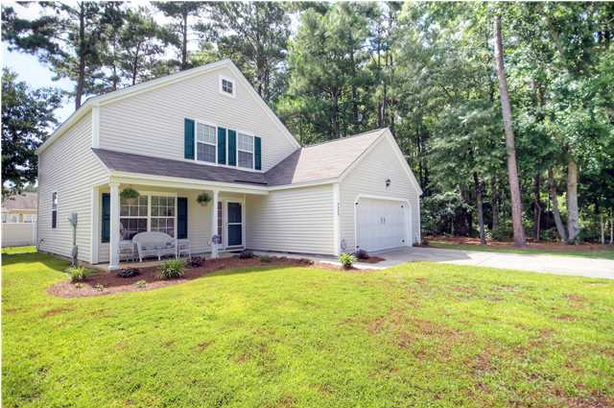
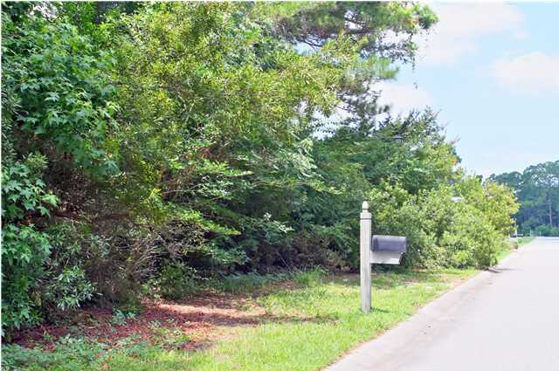
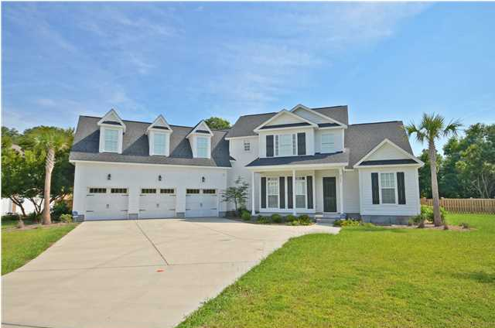
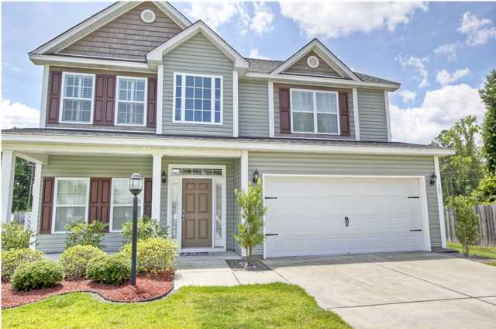
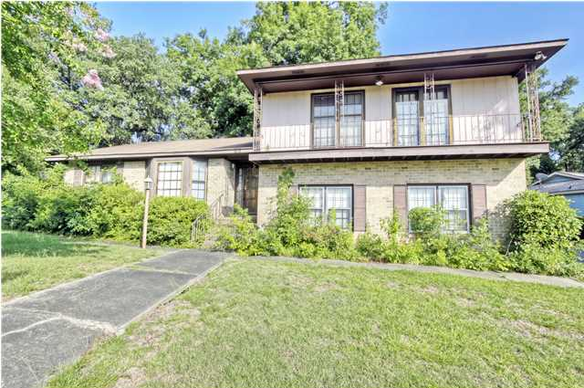
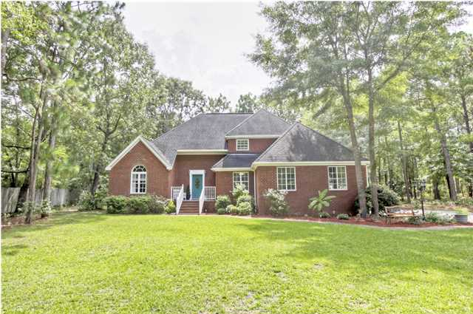
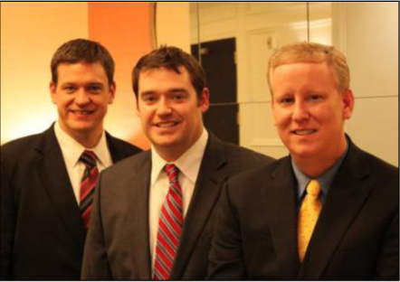

ChuckTown Homes New Listings!!
The Farm at Wescott
Summerville
$159,900
MLS# 1418009
Kiawah River Estates
Johns Island
$59,900
MLS# 1416650
Click here to view listing
24-hour Information Hotline
888-210-3348 x2929
Click here to view listing
24-hour Information Hotline
888-210-3348 x3389
Fosters Glenn
Johns Island
$425,000
MLS# 1417363
Highwoods Plantation
Summerville
$214,900
MLS# 1418706
Click here to view listing
24-hour Information Hotline
888-210-3348 x3709
Click here to view listing
24-hour Information Hotline
888-210-3348 x2889
Dominion Hills
Hanahan
$175,000
MLS# 1418743
Deer Ridge Estes
Huger
$350,000
MLS# 1419128
Click here to view listing
24-hour Information Hotline
888-210-3348 x2829
Click here to view listing
24-hour Information Hotline
888-210-3348 x2819
The ChuckTown Homes Team
Owners:
Donald Russell, Jeremy Wilson, Shawn Pillion
Buyers Specialists:
Andrea Parler, Megan Tice, Tammie Phillips, Cayce Hennessee, Polly Cillpam
Phone: 888-210-3348
info@chucktownhomes.com
www.chucktownhomes.com

