Slide 1
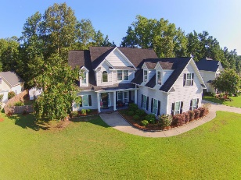
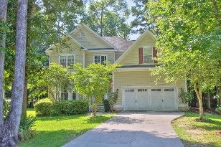
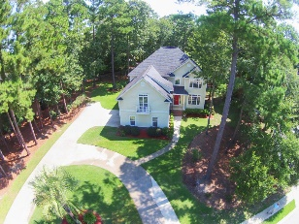
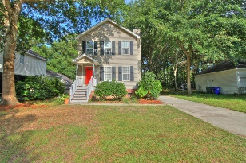
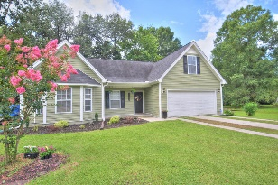
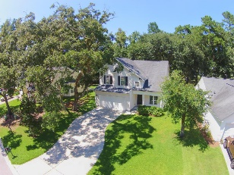
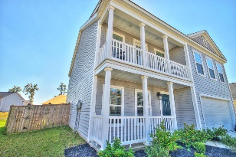
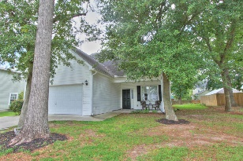
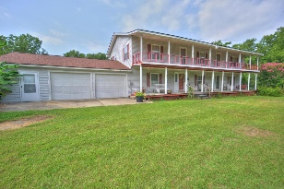
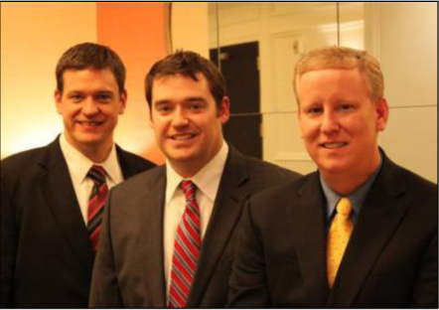

ChuckTown Homes New Listings!!
High Meadow Farms
Summerville
$375,000
MLS# 15019959
Hunt Club
West Ashley
$365,000
MLS# 15020641
Coosaw Creek CC
North Charleston
$409,900
MLS# 15020702
Click here to view listing
24-hour Information Hotline
888-210-3348 x2399
Click here to view listing
24-hour Information Hotline
888-210-3348 x4409
Click here to view listing
24-hour Information Hotline
888-210-3348 x4209
Under Contract in 3 Days!
Stonefield
Charleston
$272,000
MLS# 15020260
Jo Eva Cove
West Ashley
$219,900
MLS# 15020587
Whitehall
North Charleston
$214,900
MLS# 15019981
Click here to view listing
24-hour Information Hotline
888-210-3348 x2359
Click here to view listing
24-hour Information Hotline
888-210-3348 x2509
Click here to view listing
24-hour Information Hotline
888-210-3348 x2559
Under Contract in 7 Days!
Royal Oaks
Goose Creek
$205,000
MLS# 15019294
The Shadows
West Ashley
$239,900
MLS# 15020941
No Subdivision
Pineville
$150,000
MLS# 15020978
Click here to view listing
24-hour Information Hotline
888-210-3348 x3199
Click here to view listing
24-hour Information Hotline
888-210-3348 x2429
Click here to view listing
24-hour Information Hotline
888-210-3348 x2299
Under Contract in under 24 hours!
Under Contract in 3 Days!
ChuckTown Homes Real Estate
Owners:
Donald Russell, Jeremy Wilson, Shawn Pillion
Buyer Specialists:
Andrea Parler, Tammie Phillips, Polly Cillpam, Ashley Towns, Taylor Taylor, Steve Baller, & Luis Bordon
Phone: 888-210-3348
info@ChuckTownHomes.com
www.ChuckTownHomes.com

