Slide 1
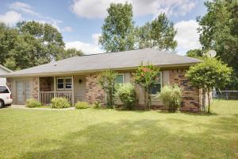
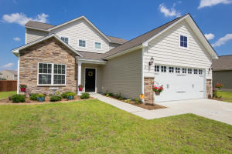
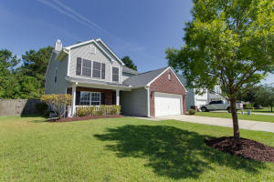
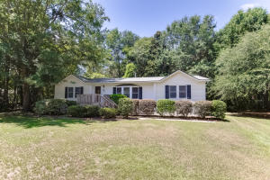
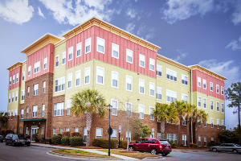
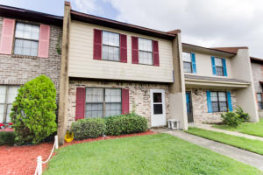
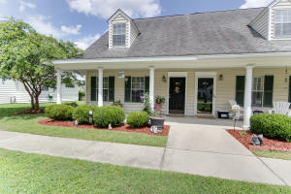
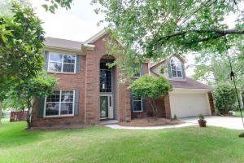
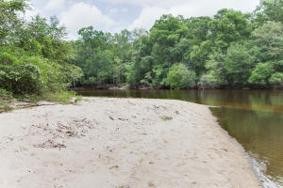
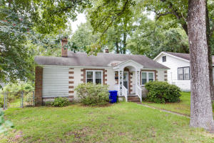
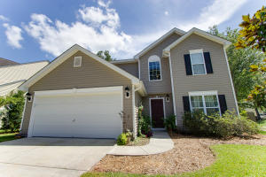
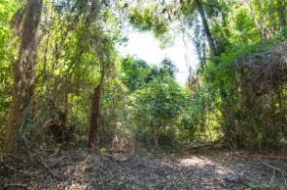
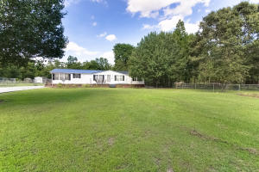
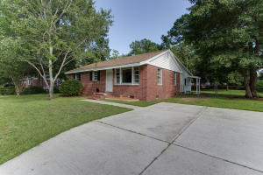
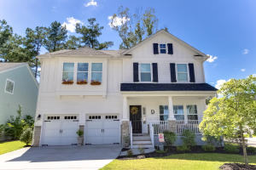
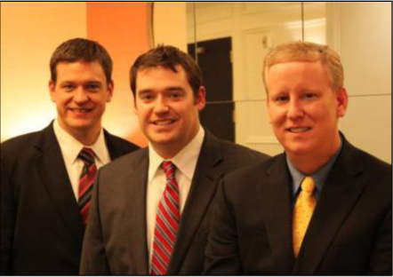

ChuckTown Homes New Listings!!
Woodside Manor
Ladson
$85,000
MLS# 16020611
Cane Bay Plantation
Summerville
$250,000
MLS# 16020041
Weatherstone
Summerville
$229,000
MLS# 16020076
Click here to view listing
24-hour Information Hotline
888-210-3348 x2279
Click here to view listing
24-hour Information Hotline
888-210-3348 x3789
Click here to view listing
24-hour Information Hotline
888-210-3348 x3679
Under contract
in 2 days!
Under Contract
in 2 days!
Anglers Pond
Johns Island
$159,900
MLS# 16019898
Palmetto Place
Charleston
$115,500
MLS# 16014255
Collins Park Villas
Charleston
$95,000
MLS# 16021275
Under Contract
in 3 Days!
Under Contract
in 11 Days!
Under Contract
in 11 Days!
Click here to view listing
24-hour Information Hotline
888-210-3348 x3299
Click here to view listing
24-hour Information Hotline
888-210-3348 x3819
Click here to view listing
24-hour Information Hotline
888-210-3348 x2329
Multiple offers in less than a week!
Under contract within a week!!
Wescott Plantation
Summerville
$134,000
MLS# 16020680
Village Green
Charleston
$309,000
MLS# 16020156
Edisto River
Round O
$250,000
MLS# 16020794
Click here to view listing
24-hour Information Hotline
888-210-3348 x4179
Click here to view listing
24-hour Information Hotline
888-210-3348 x3609
Click here to view listing
24-hour Information Hotline
888-210-3348 x2809
Under contract in 48 hours!
Carolina Terrace
Charleston
$239,900
MLS# 16021428
Arbor Oaks
Summerville
$209,900
MLS# 16021228
Seabrooks
Charleston
$120,000
MLS# 16019458
Click here to view listing
24-hour Information Hotline
888-210-3348 x3109
Click here to view listing
24-hour Information Hotline
888-210-3348 x3189
Click here to view listing
24-hour Information Hotline
888-210-3348 x2399
Under contract
in 4 days!
Bonneau Estates
Bonneau
$143,567
MLS# 16019502
Pineview
Goose Creek
$109,000
MLS# 16020780
The Ponds
Summerville
$350,000
MLS# 16020176
Click here to view listing
24-hour Information Hotline
888-210-3348 x3749
Click here to view listing
24-hour Information Hotline
888-210-3348 x2379
Click here to view listing
24-hour Information Hotline
888-210-3348 x4109
Under contract in 24 hours!
Under Contract
in 1 day!
ChuckTown Homes Real Estate
Owners:
Donald Russell, Jeremy Wilson, Shawn Pillion
Buyer Specialists:
Andrea Parler, Polly Cillpam, Ashley Towns,
Taylor Taylor, Daniel Bushby, Scott Plumer & Luis Bordon
Phone: 888-210-3348
info@ChuckTownHomes.com
www.ChuckTownHomes.com

