Slide 1
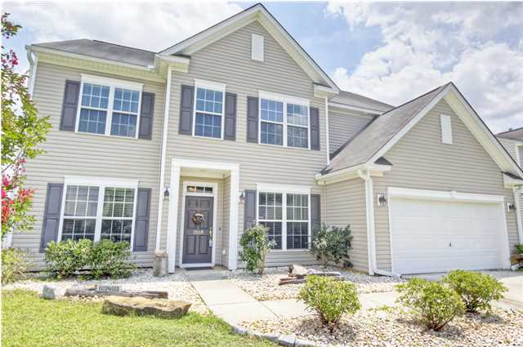
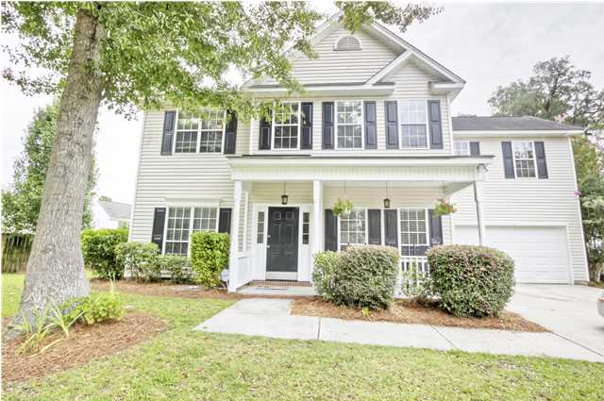
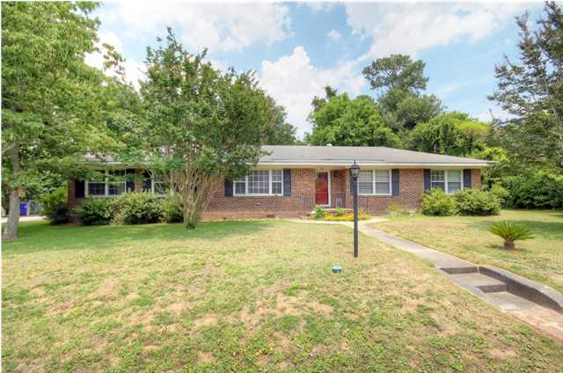
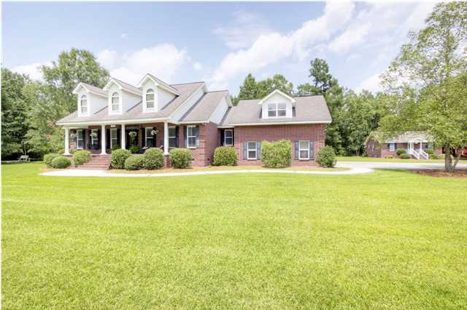
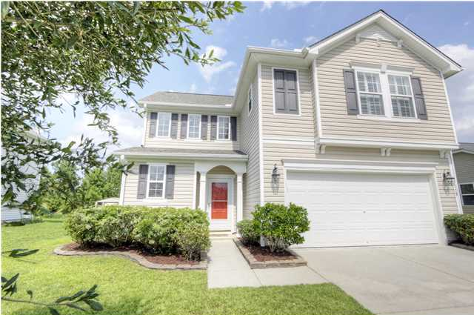
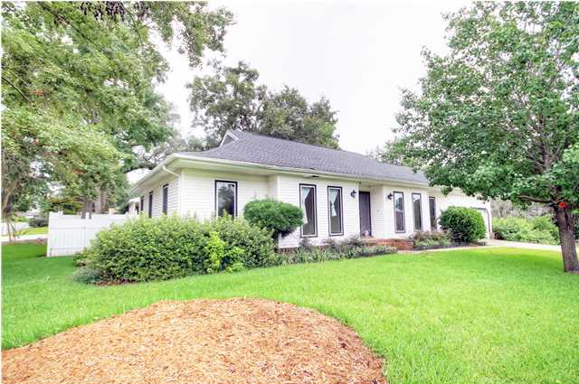
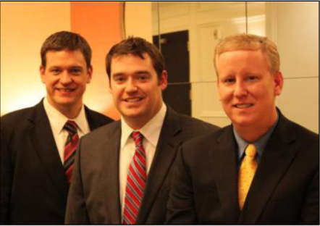

ChuckTown Homes New Listings!!
Tanner Plantation
Hanahan
$279,900
MLS# 1419132
Whitehall
North Charleston
$219,900
MLS# 1419339
Click here to view listing
24-hour Information Hotline
888-210-3348 x2329
Click here to view listing
24-hour Information Hotline
888-210-3348 x2279
Battery Point
Charleston
$339,900
MLS# 1419618
Lewisfield Plantation
Moncks Corner
$550,000
MLS# 1420431
Click here to view listing
24-hour Information Hotline
888-210-3348 x2209
Click here to view listing
24-hour Information Hotline
888-210-3348 x2809
Tanner Plantation
Hanahan
$209,900
MLS# 1420486
Dominion Hills
Hanahan
$250,000
MLS# 1420891
Click here to view listing
24-hour Information Hotline
888-210-3348 x2199
Click here to view listing
24-hour Information Hotline
888-210-3348 x2769
The ChuckTown Homes Team
Owners:
Donald Russell, Jeremy Wilson, Shawn Pillion
Buyers Specialists:
Andrea Parler, Megan Tice, Tammie Phillips, Cayce Hennessee, Polly Cillpam, Ashley Towns
Phone: 888-210-3348
info@chucktownhomes.com
www.chucktownhomes.com

