Slide 1
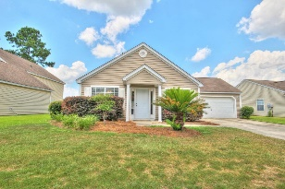
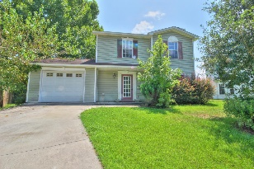
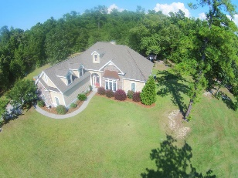
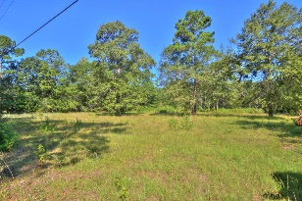
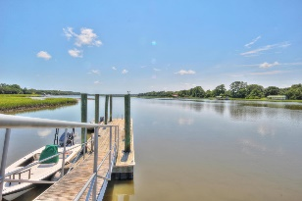
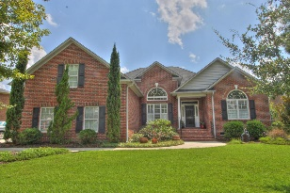
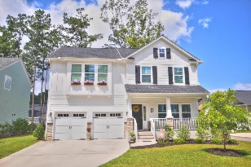
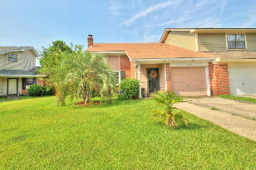
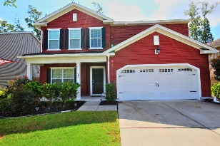
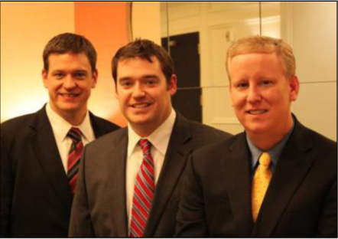

ChuckTown Homes New Listings!!
Farm at Wescott
Summerville
$159,900
MLS# 15021503
Ashley Plantation
Summerville
$125,000
MLS# 15021619
Eagle Harbor
Summerville
$300,000
MLS# 15021557
Click here to view listing
24-hour Information Hotline
888-210-3348 x2269
Click here to view listing
24-hour Information Hotline
888-210-3348 x3319
Click here to view listing
24-hour Information Hotline
888-210-3348 x3039
Under Contract in 3 Days!
Under Contract in 11 Days!
Under Contract in 11 Days!
Under Contract in 3 Days!
Hollywood
$50,000
MLS# 15021635
Cottage Plantation
Johns Island
$120,000
MLS# 15021272
Crowfield Plantation
Goose Creek
$375,000
MLS# 15021524
Click here to view listing
24-hour Information Hotline
888-210-3348 x2809
Click here to view listing
24-hour Information Hotline
888-210-3348 x2909
Click here to view listing
24-hour Information Hotline
888-210-3348 x2689
Under Contract in 2 Days!
Under Contract in 7 Days!
The Ponds
Summerville
$350,000
MLS# 15021066
Forest Hills II
North Charleston
$95,000
MLS# 15021860
Taylor Plantation
North Charleston
$275,000
MLS# 15021909
Click here to view listing
24-hour Information Hotline
888-210-3348 x4129
Click here to view listing
24-hour Information Hotline
888-210-3348 x2609
Click here to view listing
24-hour Information Hotline
888-210-3348 x2439
Under Contract in under 24 hours!
Under Contract in 2 Days!
ChuckTown Homes Real Estate
Owners:
Donald Russell, Jeremy Wilson, Shawn Pillion
Buyer Specialists:
Andrea Parler, Tammie Phillips, Polly Cillpam, Ashley Towns, Taylor Taylor, Steve Baller, & Luis Bordon
Phone: 888-210-3348
info@ChuckTownHomes.com
www.ChuckTownHomes.com

