Slide 1
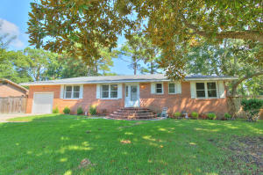
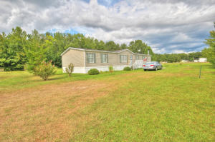
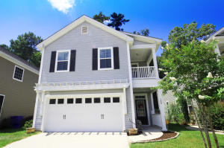
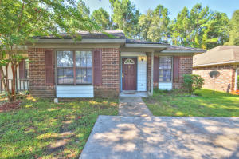
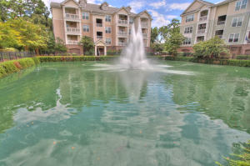
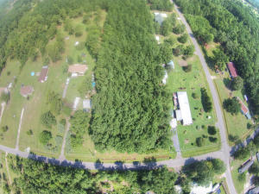
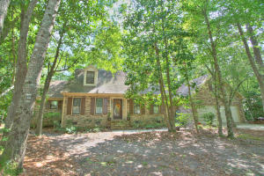
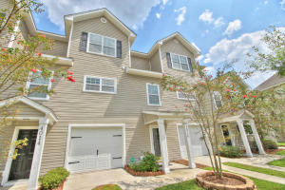
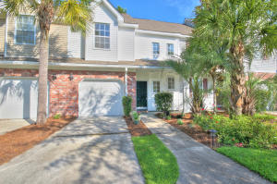
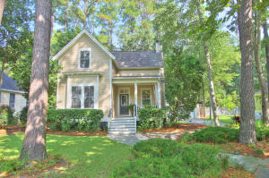
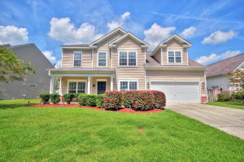
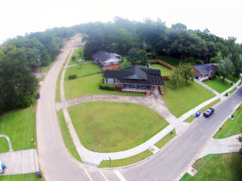
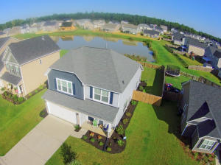
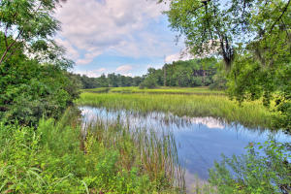
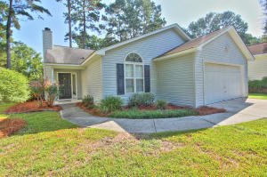
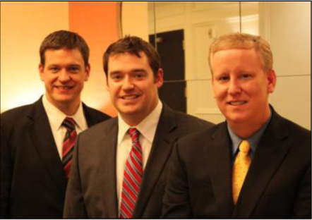

ChuckTown Homes New Listings!!
West Oak Forest
West Ashley
$200,000
MLS# 15022066
Ridgeville
$125,000
MLS# 15022004
Eagle Run
Ladson
$200,000
MLS# 15022101
Click here to view listing
24-hour Information Hotline
888-210-3348 x2579
Click here to view listing
24-hour Information Hotline
888-210-3348 x2209
Click here to view listing
24-hour Information Hotline
888-210-3348 x2199
Under Contract in 4 Days!
Under Contract in 9 Days!
Under Contract in 4 Days!
College Park Duplexes
Ladson
$75,000
MLS# 15022253
Arboretum
West Ashley
$200,000
MLS# 15022187
Summerville
$65,000
MLS# 15022256
Under Contract in 3 Days!
Under Contract in 11 Days!
Under Contract in 11 Days!
Click here to view listing
24-hour Information Hotline
888-210-3348 x2669
Click here to view listing
24-hour Information Hotline
888-210-3348 x3249
Click here to view listing
24-hour Information Hotline
888-210-3348 x2709
Under Contract in 12 Days!
Ashborough East
Summerville
$323,000
MLS# 15022288
Ashley Park
West Ashley
$189,900
MLS# 15022307
Grand Oaks Plantation
West Ashley
$185,900
MLS# 15022438
Click here to view listing
24-hour Information Hotline
888-210-3348 x3139
Click here to view listing
24-hour Information Hotline
888-210-3348 x2919
Click here to view listing
24-hour Information Hotline
888-210-3348 x3669
Under Contract in 9 Days!
The Villages in St. Johns
Johns Island
$410,000
MLS# 15022582
Summer Park
Ladson
$219,900
MLS# 15023092
Park Circle
North Charleston
$189,900
MLS# 15023192
Click here to view listing
24-hour Information Hotline
888-210-3348 x2109
Click here to view listing
24-hour Information Hotline
888-210-3348 x2999
Click here to view listing
24-hour Information Hotline
888-210-3348 x2929
Multiple offers in 24 Hours
Spring Grove Plantation
Moncks Corner
$214,900
MLS# 15023145
James Island
$275,000
MLS# 15023203
Winnsboro Lakes
Johns Island
$204,900
MLS# 15022244
Click here to view listing
24-hour Information Hotline
888-210-3348 x3479
Click here to view listing
24-hour Information Hotline
888-210-3348 x2359
Click here to view listing
24-hour Information Hotline
888-210-3348 x2479
Under Contract in 5 Days!
ChuckTown Homes Real Estate
Owners:
Donald Russell, Jeremy Wilson, Shawn Pillion
Buyer Specialists:
Andrea Parler, Tammie Phillips, Polly Cillpam, Ashley Towns, Taylor Taylor, Steve Baller, & Luis Bordon
Phone: 888-210-3348
info@ChuckTownHomes.com
www.ChuckTownHomes.com

