Slide 1
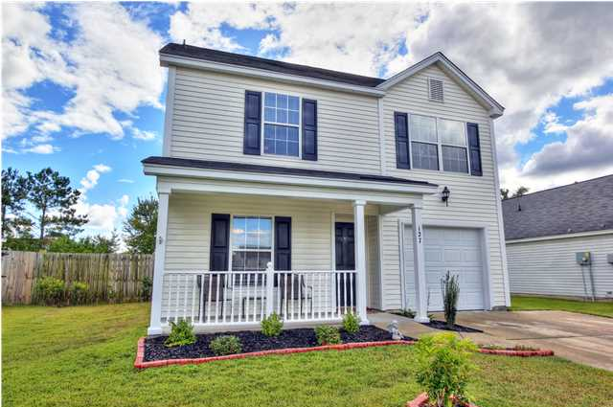
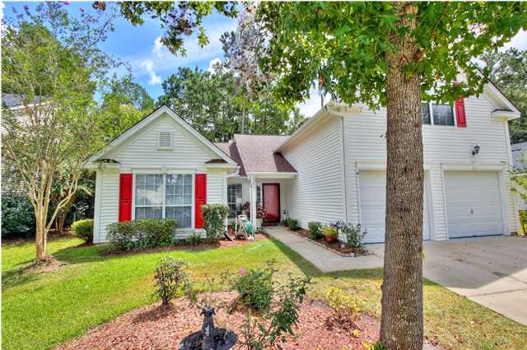
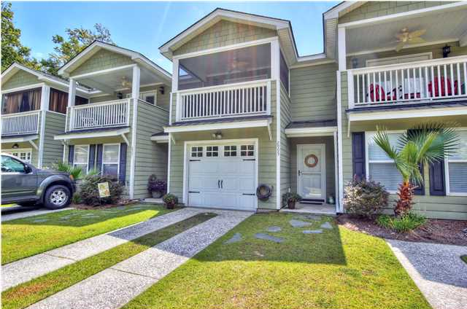
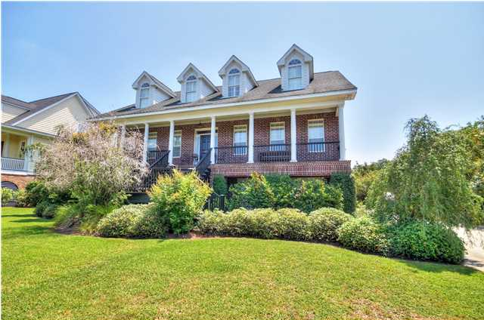
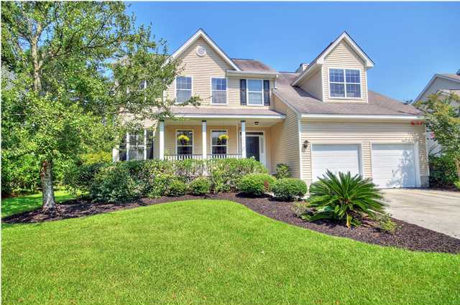
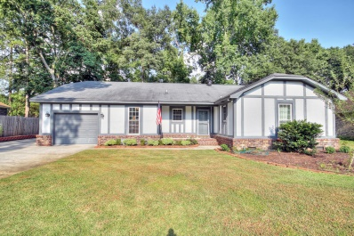
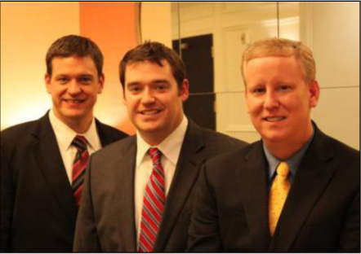

ChuckTown Homes New Listings!!
Scotts Mill
Summerville
$144,900
MLS# 1424216
Legend Oaks Plantation
Summerville $229,900
MLS# 1424273
Click here to view listing
24-hour Information Hotline
888-210-3348 x2979
Click here to view listing
24-hour Information Hotline
888-210-3348 x2429
Carol Oaks Townhomes
Mt Pleasant
$189,900
MLS# 1423600
Kiawah River Estates
Johns Island
$575,000
MLS# 1422726
Click here to view listing
24-hour Information Hotline
888-210-3348 x2549
Click here to view listing
24-hour Information Hotline
888-210-3348 x3089
Belle Hall
Mt Pleasant
$389,900
MLS# 1422651
Heathwood Charleston
$214,900
MLS# 1422719
Click here to view listing
24-hour Information Hotline
888-210-3348 x2999
Click here to view listing
24-hour Information Hotline
888-210-3348 x3009
The ChuckTown Homes Team
Owners:
Donald Russell, Jeremy Wilson, Shawn Pillion
Buyers Specialists:
Andrea Parler, Megan Tice, Tammie Phillips,
Cayce Hennessee, Polly Cillpam, Ashley Towns
Phone: 888-210-3348
info@chucktownhomes.com
www.chucktownhomes.com

