Slide 1
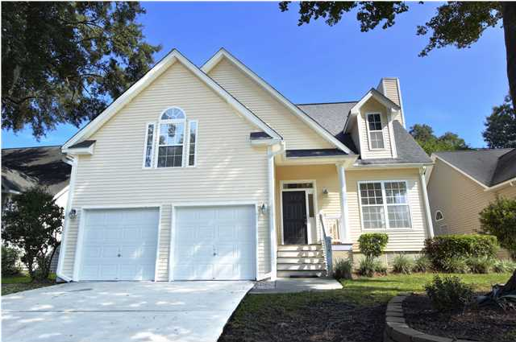
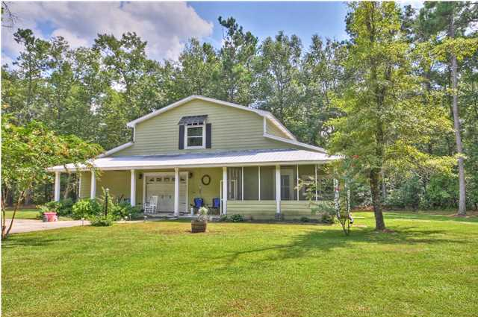
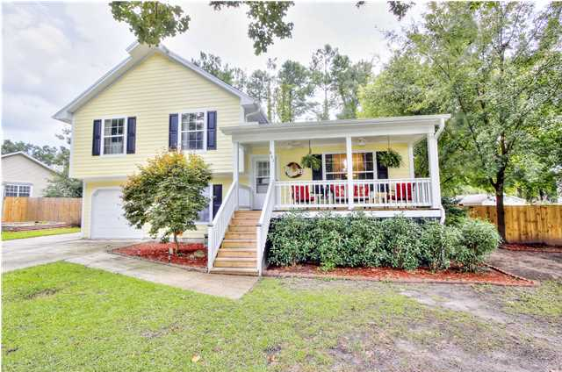
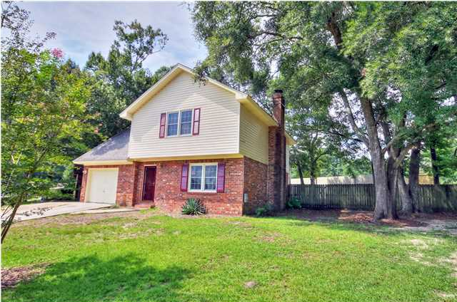
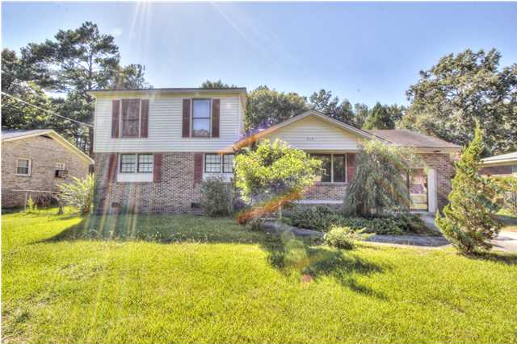
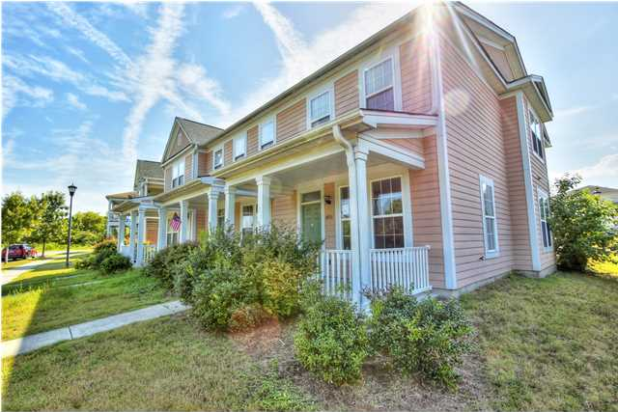
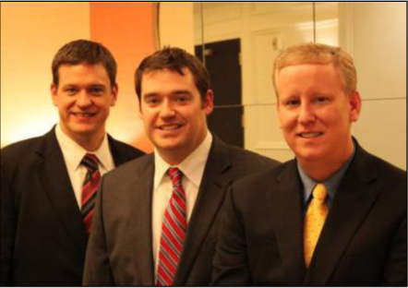

ChuckTown Homes New Listings!!
Stone Creek
Charleston
$259,900
MLS# 1421652
New Hope Estates
Summerville $300,000
MLS# 1422404
Click here to view listing
24-hour Information Hotline
888-210-3348 x2729
Click here to view listing
24-hour Information Hotline
888-210-3348 x3209
Fairfax
Goose Creek
$169,900
MLS# 1421851
White Church Place
Summerville
$142,000
MLS# 1422546
Click here to view listing
24-hour Information Hotline
888-210-3348 x2439
Click here to view listing
24-hour Information Hotline
888-210-3348 x2359
Beverly Hills
Goose Creek
$89,900
MLS# 1423296
Spring Creek at Horizon Village
North Charleston
$64,900
MLS# 1423695
Click here to view listing
24-hour Information Hotline
888-210-3348 x2959
Click here to view listing
24-hour Information Hotline
888-210-3348 x2719
The ChuckTown Homes Team
Owners:
Donald Russell, Jeremy Wilson, Shawn Pillion
Buyers Specialists:
Andrea Parler, Megan Tice, Tammie Phillips, Cayce Hennessee, Polly Cillpam, Ashley Towns
Phone: 888-210-3348
info@chucktownhomes.com
www.chucktownhomes.com

