Slide 1
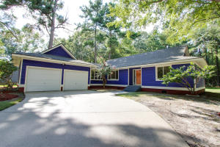
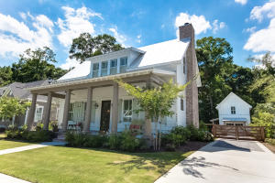
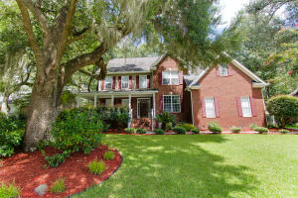
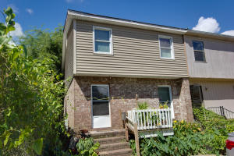
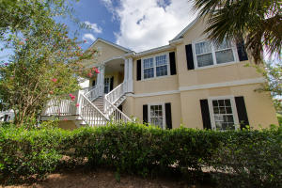
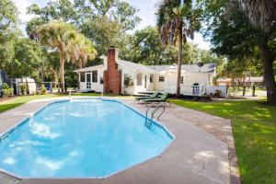
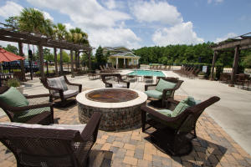
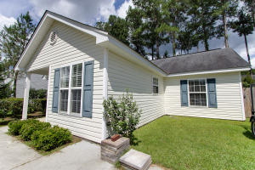
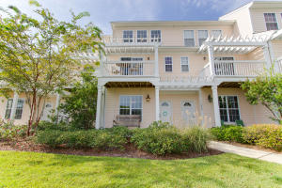
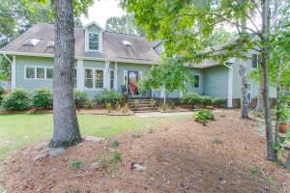
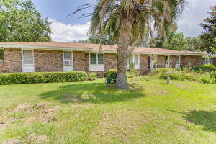
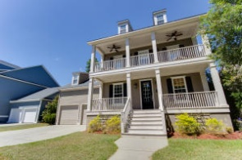
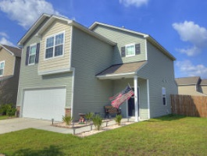
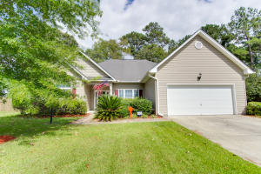
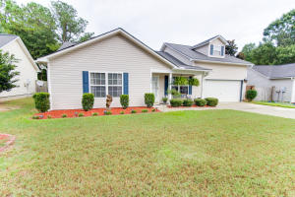
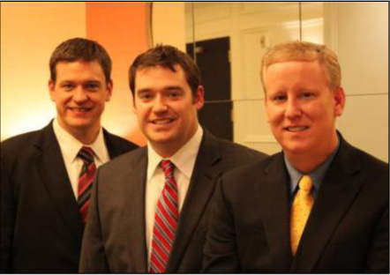

ChuckTown Homes New Listings!!
Magnolia Hill
Summerville
$129,000
MLS# 16022176
The Villages in St. Johns Woods
Johns Island
$649,000
MLS# 16018051
Whitehall
Charleston
$360,000
MLS# 16021993
Click here to view listing
24-hour Information Hotline
888-210-3348 x2639
Click here to view listing
24-hour Information Hotline
888-210-3348 x3389
Click here to view listing
24-hour Information Hotline
888-210-3348 x2699
Under contract
in 2 days!
Under Contract
Within 1 Week!
Downtown Charleston
Charleston
$200,000
MLS# 16021925
Seaside Farms
Mt. Pleasant
$550,000
MLS# 16021867
Forest Trail
Isle of Palms
$725,000
MLS# 16021461
Under Contract
in 3 Days!
Under Contract
in 11 Days!
Under Contract
in 11 Days!
Click here to view listing
24-hour Information Hotline
888-210-3348 x3139
Click here to view listing
24-hour Information Hotline
888-210-3348 x3649
Click here to view listing
24-hour Information Hotline
888-210-3348 x2839
Under contract within 10 Days!
Under Contract
Within 2 Weeks!
Palmetto Place
Charleston
$125,000
MLS# 16020829
Bradford Chase
Summerville
$129,900
MLS# 16022492
Whitney Lake
Johns Island
$229,000
MLS# 16022627
Click here to view listing
24-hour Information Hotline
888-210-3348 x3819
Click here to view listing
24-hour Information Hotline
888-210-3348 x2959
Click here to view listing
24-hour Information Hotline
888-210-3348 x2629
Under contract
Crowfield Plantation
Goose Creek
$385,000
MLS# 16022677
Forest Lawn
Goose Creek
$140,000
MLS# 16022710
Hamlin Plantation
Mt. Pleasant
$550,000
MLS# 16022917
Click here to view listing
24-hour Information Hotline
888-210-3348 x3319
Click here to view listing
24-hour Information Hotline
888-210-3348 x2579
Click here to view listing
24-hour Information Hotline
888-210-3348 x4839
Cane Bay Plantation
Summerville
$189,900
MLS# 16023090
Indigo Fields
North Charleston
$219,900
MLS# 16023799
Sangaree
Summerville
$189,900
MLS# 16023782
Click here to view listing
24-hour Information Hotline
888-210-3348 x3019
Click here to view listing
24-hour Information Hotline
888-210-3348 x2559
Click here to view listing
24-hour Information Hotline
888-210-3348 x2199
Under contract
Under contract
in 2 days!
ChuckTown Homes Real Estate
Owners:
Donald Russell, Jeremy Wilson, Shawn Pillion
Buyer Specialists:
Andrea Parler, Polly Cillpam, Ashley Towns,
Taylor Taylor, Daniel Bushby, Scott Plumer & Luis Bordon
Phone: 888-210-3348
info@ChuckTownHomes.com
www.ChuckTownHomes.com

