Slide 1
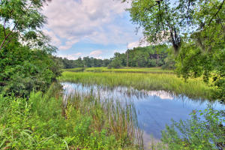
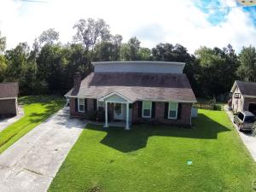
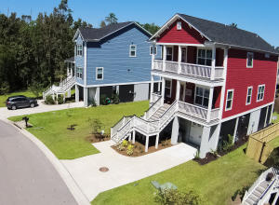
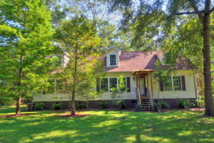
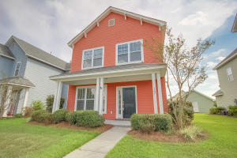
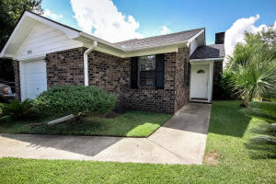
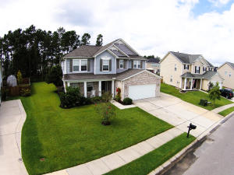
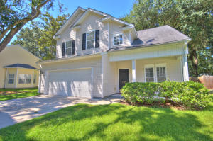
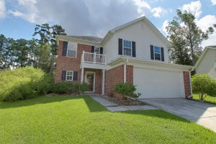
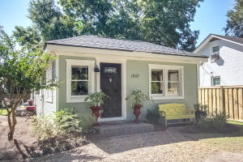
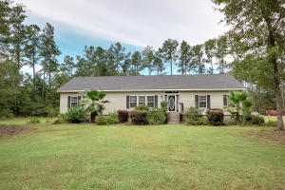
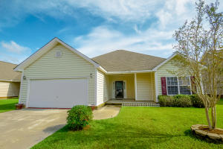
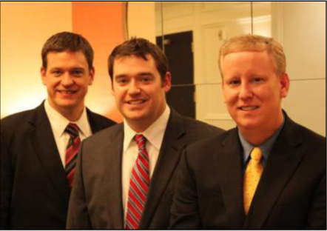

ChuckTown Homes New Listings!!
James Island
$275,000
MLS# 15023203
Greenhurst
Summerville
$179,000
MLS# 15024033
Retreat at Bereford
Wando
$375,000
MLS# 15024376
Click here to view listing
24-hour Information Hotline
888-210-3348 x2359
Click here to view listing
24-hour Information Hotline
888-210-3348 x3019
Click here to view listing
24-hour Information Hotline
888-210-3348 x2839
Under Contract in 6 Days!
Adams Run
$300,000
MLS# 15024005
White Gables
Summerville
$164,900
MLS# 15023964
Forest Hills
North Charleston
$80,000
MLS# 15023816
Click here to view listing
24-hour Information Hotline
888-210-3348 x2719
Click here to view listing
24-hour Information Hotline
888-210-3348 x3689
Click here to view listing
24-hour Information Hotline
888-210-3348 x2779
Foxbank Plantation
Moncks Corner
$219,900
MLS# 15023784
Whitehall
North Charleston
$209,900
MLS# 15024282
Eagle Run
Ladson
$150,000
MLS# 15023869
Click here to view listing
24-hour Information Hotline
888-210-3348 x3179
Click here to view listing
24-hour Information Hotline
888-210-3348 x2559
Click here to view listing
24-hour Information Hotline
888-210-3348 x2449
Under Contract in 7 Days!
Under Contract in 8 Days!
James Island
$215,000
MLS# 15024510
West Ashley
$200,000
MLS# 15024203
Brookdale
North Charleston
$175,000
MLS# 15023739
Under Contract in 3 Days!
Under Contract in under 24 hours!
Click here to view listing
24-hour Information Hotline
888-210-3348 x3499
Click here to view listing
24-hour Information Hotline
888-210-3348 x3789
Click here to view listing
24-hour Information Hotline
888-210-3348 x2439
ChuckTown Homes Real Estate
Owners:
Donald Russell, Jeremy Wilson, Shawn Pillion
Buyer Specialists:
Andrea Parler, Tammie Phillips, Polly Cillpam, Ashley Towns, Taylor Taylor, Steve Baller, & Luis Bordon
Phone: 888-210-3348
info@ChuckTownHomes.com
www.ChuckTownHomes.com

