Slide 1
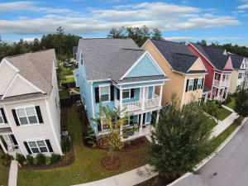
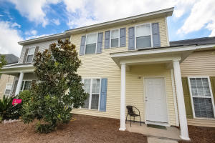
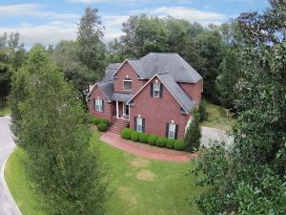
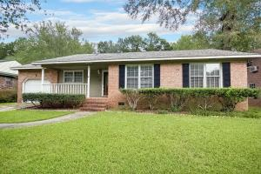
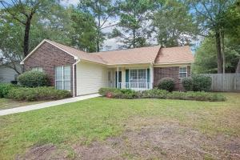
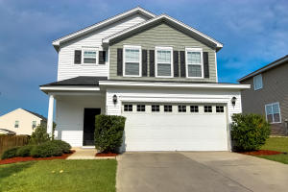
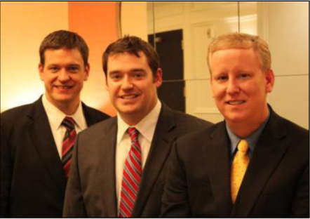

ChuckTown Homes New Listings!!
The Ponds
Summerville
$259,900
MLS# 15025019
Lakes of Summerville
$109,900
MLS# 15024980
Under Contract
in 6 Days!
Click here to view listing
24-hour Information Hotline
888-210-3348 X.4109
Click here to view listing
24-hour Information Hotline
888-210-3348 X.2789
Bakers Landing
North Charleston
$330,000
MLS# 15025549
Tall Pines
Ladson
$129,900
MLS# 15025553
Under Contract
in 8 Days!
Click here to view listing
24-hour Information Hotline
888-210-3348 X.2379
Click here to view listing
24-hour Information Hotline
888-210-3348 X.3759
Under Contract
in 7 Days!
Windsor Hill
North Charleston
$150,000
MLS# 15025508
Mckewn
Ladson
$200,000
MLS# 15024838
Under Contract
in 3 Days!
Under Contract in under 24 hours!
Click here to view listing
24-hour Information Hotline
888-210-3348 X.2769
Click here to view listing
24-hour Information Hotline
888-210-3348 X.4009
ChuckTown Homes Real Estate
Owners:
Donald Russell, Jeremy Wilson, Shawn Pillion
Buyer Specialists:
Andrea Parler, Tammie Phillips, Polly Cillpam,
Ashley Towns, Taylor Taylor, Steve Baller, & Luis Bordon
Phone: 888-210-3348
info@ChuckTownHomes.com
www.ChuckTownHomes.com

