Slide 1
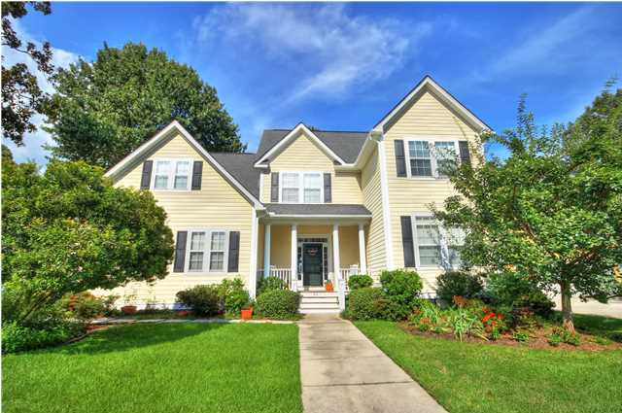
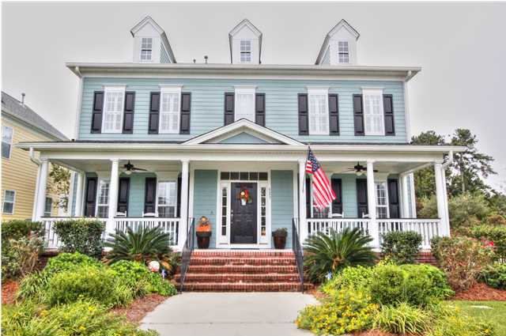
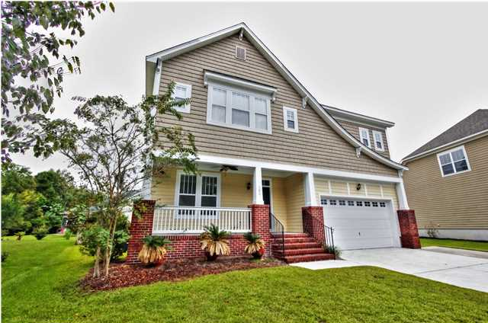
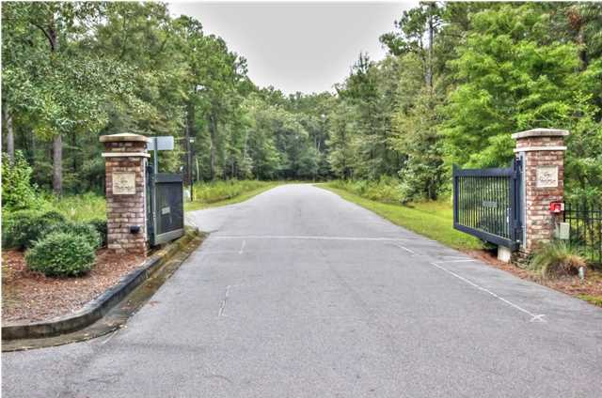
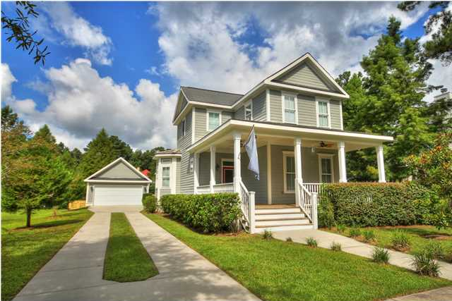
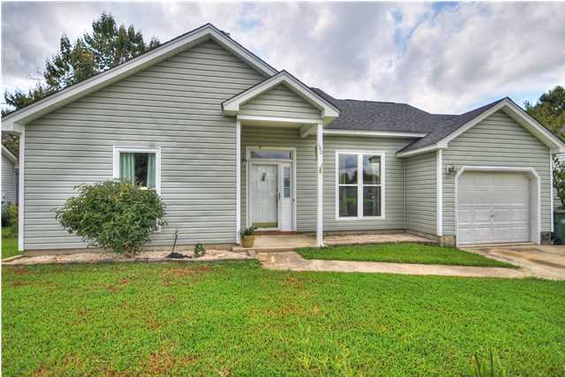
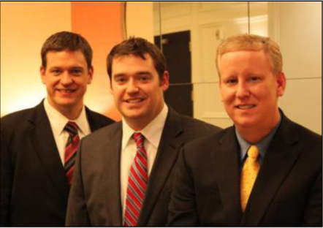

ChuckTown Homes New Listings!!
Schieveling Plantation
Charleston
$475,000
MLS# 1424892
White Gables
Summerville $325,000
MLS# 1425862
Click here to view listing
24-hour Information Hotline
888-210-3348 x2399
Click here to view listing
24-hour Information Hotline
888-210-3348 x3709
Legend Oaks Plantation
Summerville
$285,000
MLS# 1425830
The Refuge at Ravenel
Ravenel
$50,000
MLS# 1425829
Click here to view listing
24-hour Information Hotline
888-210-3348 x2579
Click here to view listing
24-hour Information Hotline
888-210-3348 x3029
The Villages in St Johns Woods
Johns Island
$369,900
MLS# 1424889
Oak Creek
Goose Creek
$145,000
MLS# 1424961
Click here to view listing
24-hour Information Hotline
888-210-3348 x2109
Click here to view listing
24-hour Information Hotline
888-210-3348 x3109
The ChuckTown Homes Team
Owners:
Donald Russell, Jeremy Wilson, Shawn Pillion
Buyers Specialists:
Andrea Parler, Megan Tice, Tammie Phillips, Cayce Hennessee, Polly Cillpam, Ashley Towns
Phone: 888-210-3348
info@chucktownhomes.com
www.chucktownhomes.com

