Slide 1
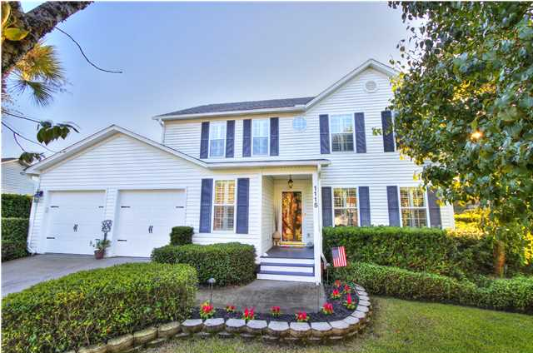
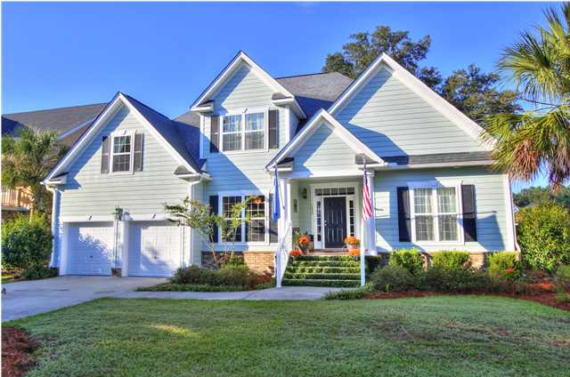
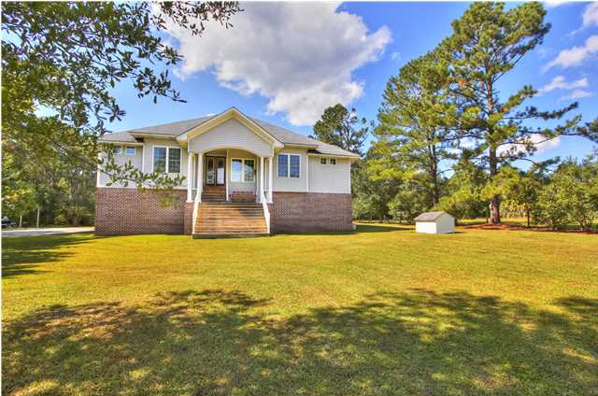
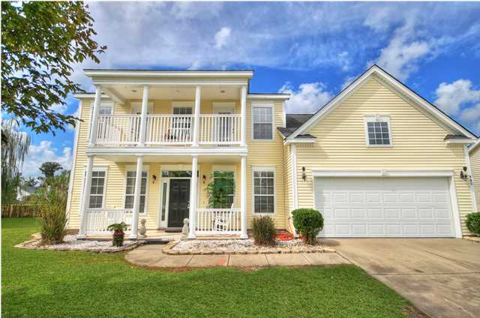
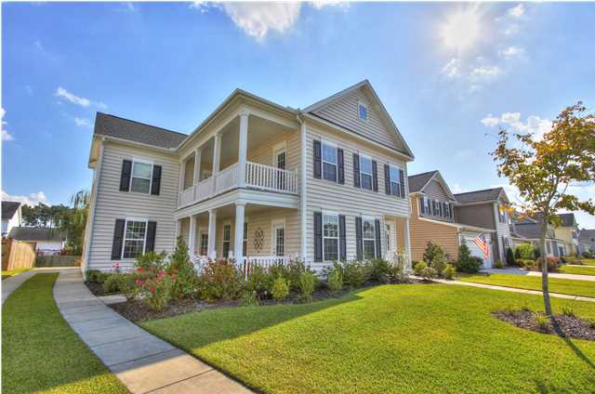
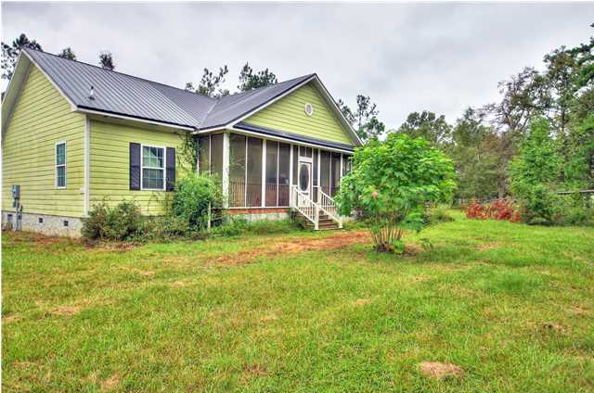
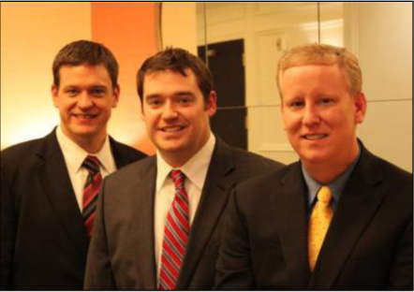

ChuckTown Homes New Listings!!
Bayview Farms
Charleston
$389,900
MLS# 1426373
River Reach Pointe
Charleston
$420,000
MLS# 1426414
Click here to view listing
24-hour Information Hotline
888-210-3348 x3499
Click here to view listing
24-hour Information Hotline
888-210-3348 x3319
Macedonia
Bonneau
$325,000
MLS# 1426793
Grand Oaks Plantation
Charleston
$300,000
MLS# 1426743
Click here to view listing
24-hour Information Hotline
888-210-3348 x3649
Click here to view listing
24-hour Information Hotline
888-210-3348 x2299
Wentworth Hall
Summerville
$269,900
MLS# 1426396
Farm Hill Acres
Cross
$125,000
MLS# 1425930
Click here to view listing
24-hour Information Hotline
888-210-3348 x3069
Click here to view listing
24-hour Information Hotline
888-210-3348 x2049
The ChuckTown Homes Team
Owners:
Donald Russell, Jeremy Wilson, Shawn Pillion
Buyers Specialists:
Andrea Parler, Megan Tice, Tammie Phillips, Polly Cillpam, Ashley Towns
Phone: 888-210-3348
info@chucktownhomes.com
www.chucktownhomes.com

