Slide 1
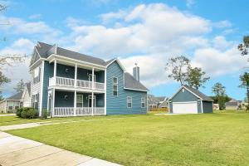
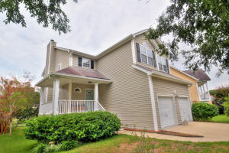
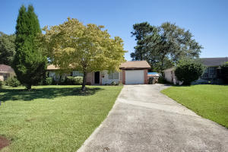
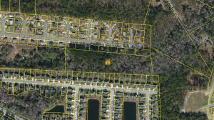
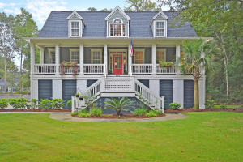
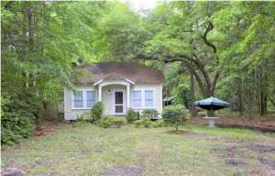
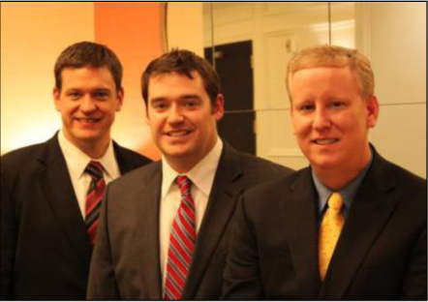

ChuckTown Homes New Listings!!
Boltons Landing
Charleston
$300,000
MLS# 15025791
Stone Creek
Charleston
$263,000
MLS# 15026025
Under Contract in 6 Days!
Click here to view listing
24-hour Information Hotline
888-210-3348 X.2129
Click here to view listing
24-hour Information Hotline
888-210-3348 X.3649
Okatee
Summerville
$125,000
MLS# 15026126
Johns Island
$225,000
MLS# 15026265
Under Contract in 8 Days!
Click here to view listing
24-hour Information Hotline
888-210-3348 X.3619
Click here to view listing
24-hour Information Hotline
888-210-3348 X.3069
Under Contract in 7 Days!
Royal Harbor
Hollywood
$535,000
MLS# 15026227
Hollywood
$75,000
MLS# 15026378
Under Contract in 3 Days!
Under Contract in under 24 hours!
Click here to view listing
24-hour Information Hotline
888-210-3348 X.2549
Click here to view listing
24-hour Information Hotline
888-210-3348 X.3149
ChuckTown Homes Real Estate
Owners:
Donald Russell, Jeremy Wilson, Shawn Pillion
Buyer Specialists:
Andrea Parler, Tammie Phillips, Polly Cillpam, Ashley Towns, Taylor Taylor, Steve Baller, & Luis Bordon
Phone: 888-210-3348
info@ChuckTownHomes.com
www.ChuckTownHomes.com

