Slide 1
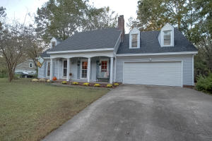
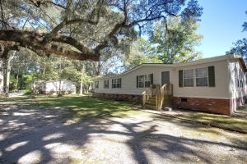
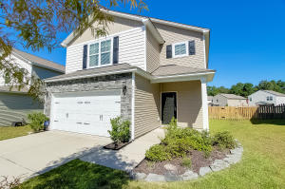
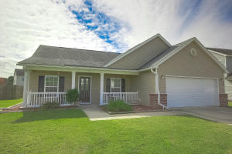
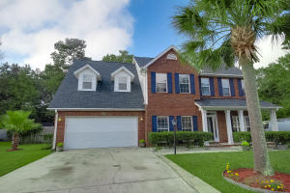
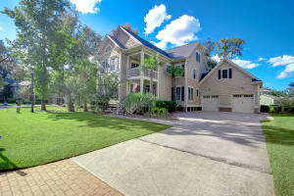
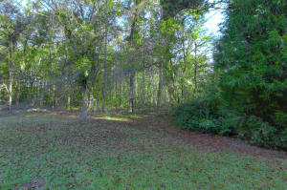
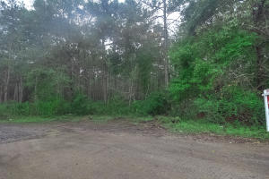
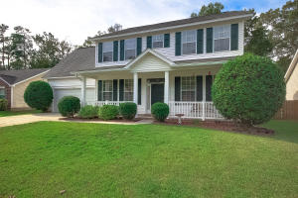
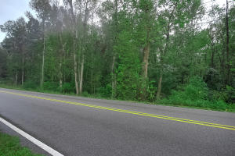
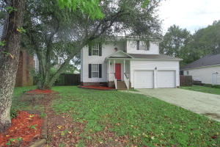
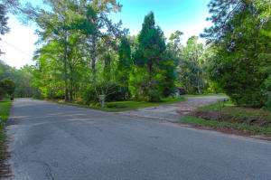
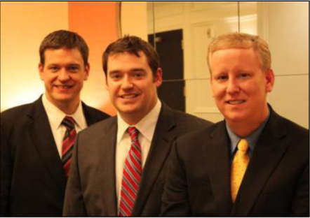

ChuckTown Homes New Listings!!
Irongate
Summerville
$215,000
MLS# 15027071
Rice Hope
Moncks Corner
$100,000
MLS# 15027042
Mckewn
Ladson
$205,000
MLS# 15027076
Click here to view listing
24-hour Information Hotline
888-210-3348 x2639
Click here to view listing
24-hour Information Hotline
888-210-3348 x3129
Click here to view listing
24-hour Information Hotline
888-210-3348 x4019
Weatherstone
Summerville
$189,900
MLS# 15027186
Providence Commons
West Ashley
$309,900
MLS# 15027373
The Refuge at Whitehall
N Charleston
$439,500
MLS# 15027391
Click here to view listing
24-hour Information Hotline
888-210-3348 x3059
Click here to view listing
24-hour Information Hotline
888-210-3348 x2419
Click here to view listing
24-hour Information Hotline
888-210-3348 x4509
Under Contract
in 6 Days!
Under Contract
in 8 Days!
Lincolnville
Summerville
$40,000
MLS# 15027819
Lincolnville
Summerville
$40,000
MLS# 15028074
Marsh Hall
N Charleston
$234,900
MLS# 15028007
Click here to view listing
24-hour Information Hotline
888-210-3348 x3749
Click here to view listing
24-hour Information Hotline
888-210-3348 x2819
Click here to view listing
24-hour Information Hotline
888-210-3348 x2339
Under Contract
in 7 Days!
Lincolnville
Summerville
$40,000
MLS# 15028078
Laurel Hill
Goose Creek
$200,000
MLS# 15028125
Lincolnville
Summerville
$50,000
MLS# 15027818
Under Contract
in 3 Days!
Under Contract in under 24 hours!
Click here to view listing
24-hour Information Hotline
888-210-3348 x2979
Click here to view listing
24-hour Information Hotline
888-210-3348 x2919
Click here to view listing
24-hour Information Hotline
888-210-3348 x2959
ChuckTown Homes Real Estate
Owners:
Donald Russell, Jeremy Wilson, Shawn Pillion
Buyer Specialists:
Andrea Parler, Polly Cillpam, Ashley Towns,
Taylor Taylor, Steve Baller, & Luis Bordon
Phone: 888-210-3348
info@ChuckTownHomes.com
www.ChuckTownHomes.com

