Slide 1
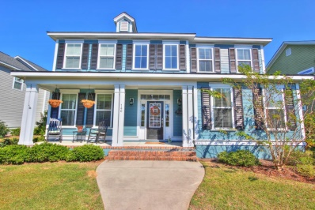
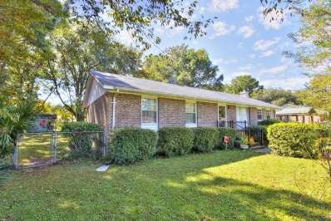
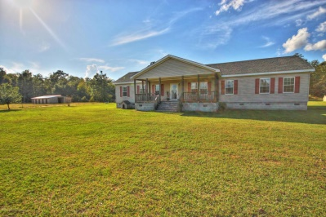
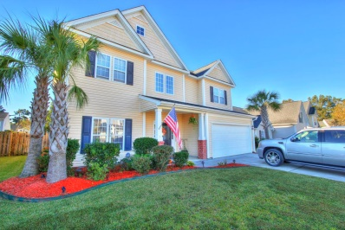
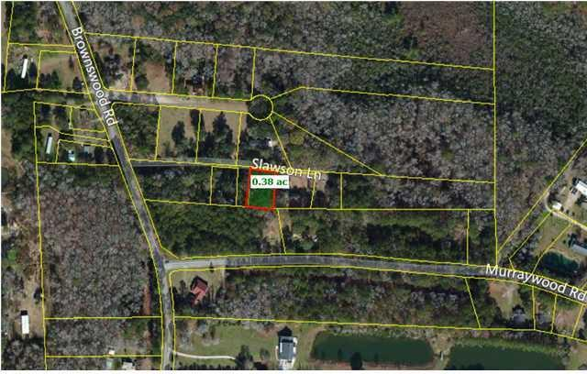
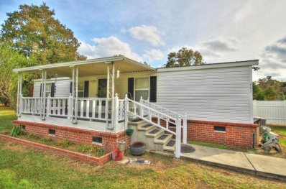
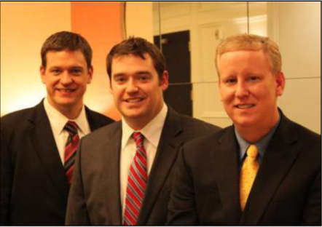

ChuckTown Homes New Listings!!
Foxbank Plantation
Moncks Corner
$300,000
MLS# 14027750
Bur Clare
Charleston
$250,000
MLS# 14027706
Click here to view listing
24-hour Information Hotline
888-210-3348 x2909
Click here to view listing
24-hour Information Hotline
888-210-3348 x3199
Dorchester
Saint George $260,000
MLS# 14027260
Under Contract
in 11 Days!
Plum Creek Summerville $225,000
MLS# 14027863
Click here to view listing
24-hour Information Hotline
888-210-3348 x2309
Click here to view listing
24-hour Information Hotline
888-210-3348 x3669
Charleston
Johns Island
$20,000
MLS# 1424450
Twin Lakes
Summerville $95,000
MLS# 14028384
Click here to view listing
24-hour Information Hotline
888-210-3348 x2749
Click here to view listing
24-hour Information Hotline
888-210-3348 x2919
The ChuckTown Homes Team
Owners:
Donald Russell, Jeremy Wilson, Shawn Pillion
Buyers Specialists:
Andrea Parler, Tammie Phillips, Polly Cillpam,
Ashley Towns, Kate McClure and Steve Baller
Phone: 888-210-3348
info@chucktownhomes.com
www.chucktownhomes.com

