Slide 1
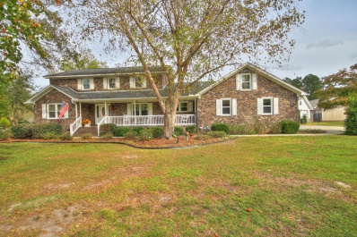
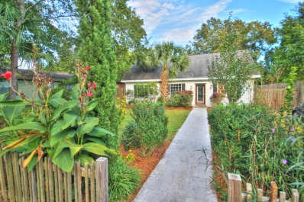
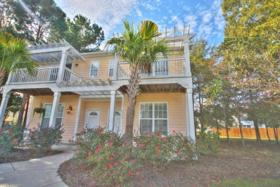
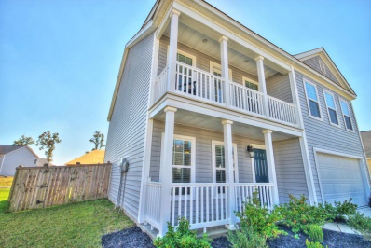
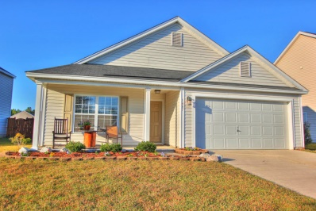
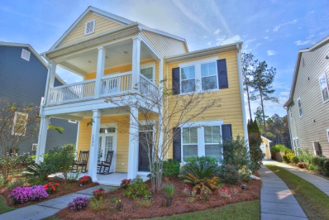
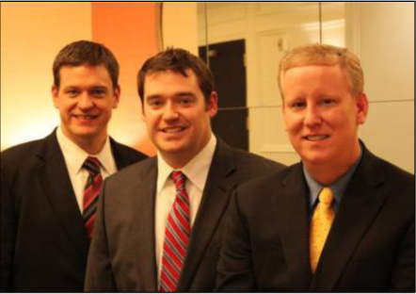

ChuckTown Homes New Listings!!
Katony
Ladson
$325,000
MLS# 14028954
Under Contract in 10 Days!
West Oak Forest
West Ashley
$225,000
MLS# 14028393
Click here to view listing
24-hour Information Hotline
888-210-3348 x3479
Click here to view listing
24-hour Information Hotline
888-210-3348 x2709
Under Contract in 11 Days!
The Gardens of Whitney Lake
Johns Island
$200,000
MLS# 14028395
Royal Oaks
Goose Creek
$210,000
MLS# 14028289
Under Contract in 11 Days!
Click here to view listing
24-hour Information Hotline
888-210-3348 x2009
Click here to view listing
24-hour Information Hotline
888-210-3348 x3179
Under Contract in 6 Days!
Drakesborough
Summerville
$150,000
MLS# 14028187
Boltons Landing
Charleston
$350,000
MLS# 14029297
Click here to view listing
24-hour Information Hotline
888-210-3348 x3609
Click here to view listing
24-hour Information Hotline
888-210-3348 x2649
The ChuckTown Homes Team
Owners:
Donald Russell, Jeremy Wilson, Shawn Pillion
Buyers Specialists:
Andrea Parler, Tammie Phillips, Polly Cillpam, Ashley Towns, Katie McClure and Steve Baller
Phone: 888-210-3348
info@chucktownhomes.com
www.chucktownhomes.com

