Slide 1
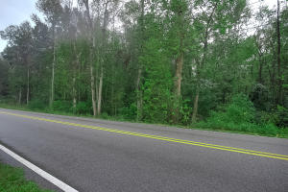
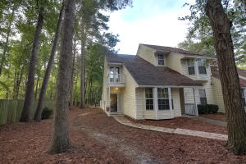
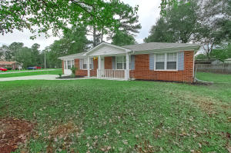
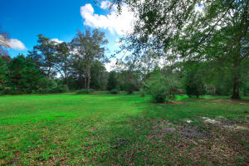
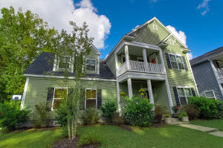
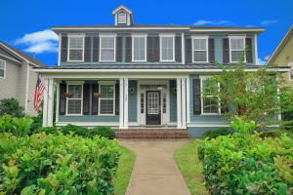
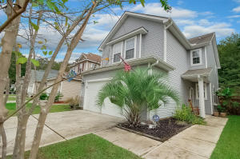
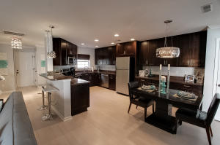
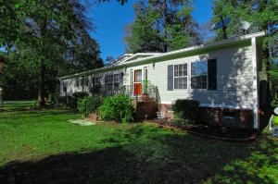
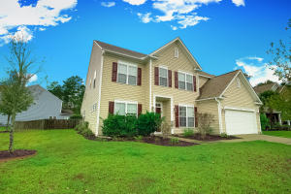
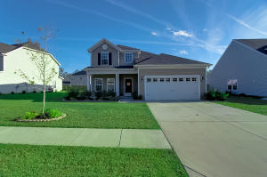
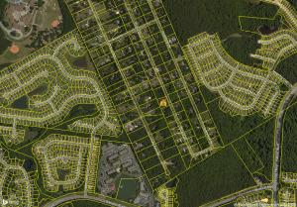
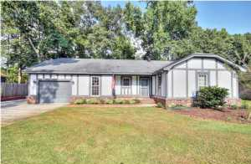
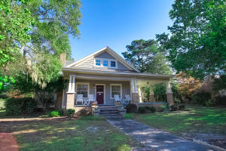
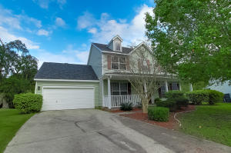
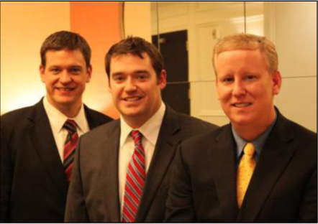

ChuckTown Homes New Listings!!
Lincolnville
Lincolnville
$40,000
MLS# 15028079
The Park at Rivers Edge
N Charleston
$75,000
MLS# 15028691
Woodland Heights
Goose Creek
$129,900
MLS# 15028513
Under Contract in 4 Days!
Click here to view listing
24-hour Information Hotline
888-210-3348 x2849
Click here to view listing
24-hour Information Hotline
888-210-3348 x2399
Click here to view listing
24-hour Information Hotline
888-210-3348 x2799
Under Contract in 4 Days!
Under Contract in 6 Days!
Susan Lauren Tract
Ravenel
$100,000
MLS# 15028452
Swygerts Landing
Johns Island
$315,000
MLS# 15028571
Foxbank Plantation
Moncks Corner
$300,000
MLS# 15028592
Under Contract in 3 Days!
Under Contract in 11 Days!
Under Contract in 11 Days!
Click here to view listing
24-hour Information Hotline
888-210-3348 x3679
Click here to view listing
24-hour Information Hotline
888-210-3348 x3739
Click here to view listing
24-hour Information Hotline
888-210-3348 x3179
Under Contract in 12 Days!
Charleston Park
N Charleston
$175,000
MLS# 15028595
Charleston Park
N Charleston
$175,000
MLS# 15028532
Hollywood
Hollywood
$150,000
MLS# 15028674
Click here to view listing
24-hour Information Hotline
888-210-3348 x2289
Click here to view listing
24-hour Information Hotline
888-210-3348 x2499
Click here to view listing
24-hour Information Hotline
888-210-3348 x2699
Wescott Plantation
Summerville
$289,900
MLS# 15028673
Spencer Creek Woods
Ladson
$200,000
MLS# 15028896
Old Fort Estates
N Charleston
$75,000
MLS# 15028814
Multiple offers in 24 Hours
Click here to view listing
24-hour Information Hotline
888-210-3348 x2069
Click here to view listing
24-hour Information Hotline
888-210-3348 x4309
Click here to view listing
24-hour Information Hotline
888-210-3348 x3709
Under Contract in 17 Days!
Heathwood
West Ashley
$219,900
MLS# 15028906
Holly Hill
Holly Hill
$175,000
MLS# 15029038
Whitehall
N Charleston
$239,900
MLS# 15029204
Click here to view listing
24-hour Information Hotline
888-210-3348 x2539
Click here to view listing
24-hour Information Hotline
888-210-3348 x2659
Click here to view listing
24-hour Information Hotline
888-210-3348 x3199
Under Contract in 8 Days!
ChuckTown Homes Real Estate
Owners:
Donald Russell, Jeremy Wilson, Shawn Pillion
Buyer Specialists:
Andrea Parler, Polly Cillpam, Ashley Towns, Taylor Taylor, Steve Baller, & Luis Bordon
Phone: 888-210-3348
info@ChuckTownHomes.com
www.ChuckTownHomes.com

