Slide 1
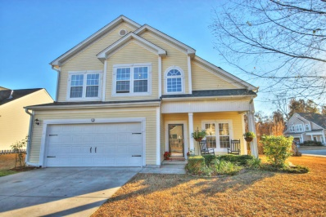
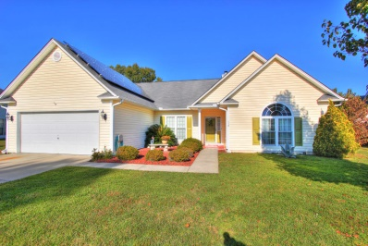
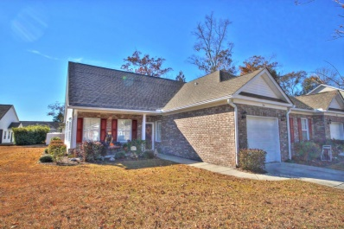
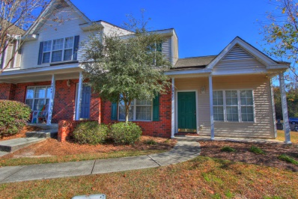
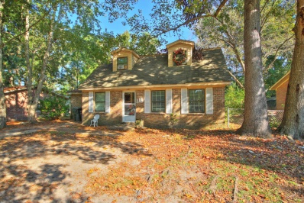
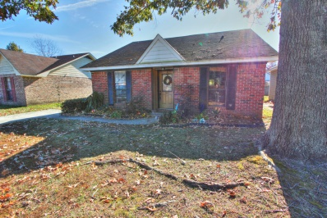
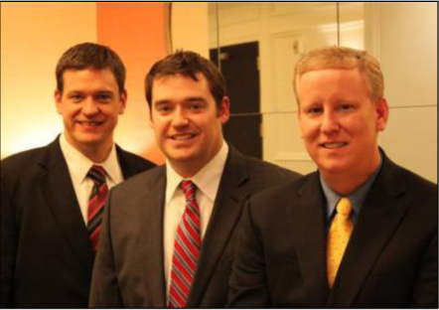

ChuckTown Homes New Listings!!
Plum Creek
Summerville
$200,000
MLS# 14030538
Under Contract
in 15 Days!
Woodland Lakes
Goose Creek
$200,000
MLS# 14028199
Click here to view listing
24-hour Information Hotline
888-210-3348 x3769
Click here to view listing
24-hour Information Hotline
888-210-3348 x3679
Under Contract
in 11 Days!
Grand Oaks Plantation
Charleston
$189,900
MLS# 14030470
Oak Bluff
North Charleston
$109,900
MLS# 14030297
Under Contract
in 11 Days!
Click here to view listing
24-hour Information Hotline
888-210-3348 x2699
Click here to view listing
24-hour Information Hotline
888-210-3348 x2229
Under Contract
in 6 Days!
Greenhurst
Summerville
$79,900
MLS# 14028451
Ashley Plantation
Summerville
$107,000
MLS# 14030232
Click here to view listing
24-hour Information Hotline
888-210-3348 x2479
Click here to view listing
24-hour Information Hotline
888-210-3348 x2769
The ChuckTown Homes Team
Owners:
Donald Russell, Jeremy Wilson, Shawn Pillion
Buyers Specialists:
Andrea Parler, Tammie Phillips, Polly Cillpam,
Ashley Towns, Katie McClure and Steve Baller
Phone: 888-210-3348
info@chucktownhomes.com
www.chucktownhomes.com

