Slide 1
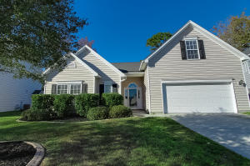
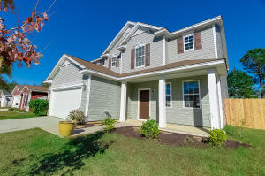
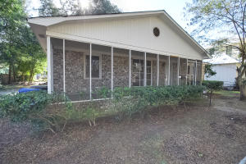
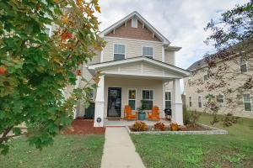
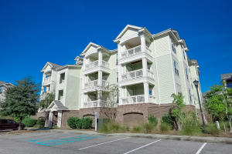
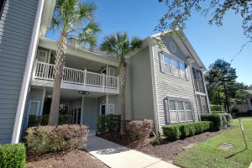
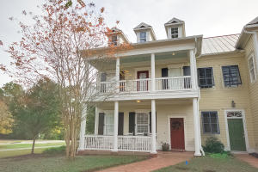
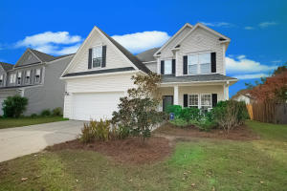
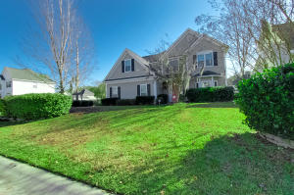
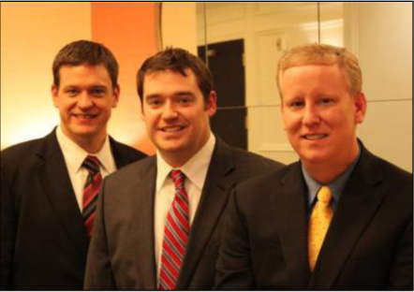

ChuckTown Homes New Listings!!
Wescott Plantation
Summerville
$215,000
MLS# 15029596
Blackberry Creek
Summerville
$225,000
MLS# 15029586
Old Village
Mt Pleasant
$500,000
MLS# 15029627
Click here to view listing
24-hour Information Hotline
888-210-3348 x3669
Click here to view listing
24-hour Information Hotline
888-210-3348 x2269
Click here to view listing
24-hour Information Hotline
888-210-3348 x2829
Under Contract in 7 Days!
Under Contract in 11 Days!
Under Contract in 3 Days!
Cokers Commons
Goose Creek
$139,500
MLS# 15029838
Arboretum
West Ashley
$189,900
MLS# 15029966
Grand Oaks Plantation
West Ashley
$150,000
MLS# 15029916
Under Contract in 2 Days!
Click here to view listing
24-hour Information Hotline
888-210-3348 x3729
Click here to view listing
24-hour Information Hotline
888-210-3348 x3249
Click here to view listing
24-hour Information Hotline
888-210-3348 x4609
Under Contract in 5 Days!
Under Contract in 7 Days!
Park West
Mt Pleasant
$359,900
MLS# 15030023
Plum Creek
Summerville
$207,900
MLS# 15030059
Plum Creek
Summerville
$244,900
MLS# 15030541
Under Contract in 2 Days!
Click here to view listing
24-hour Information Hotline
888-210-3348 x3539
Click here to view listing
24-hour Information Hotline
888-210-3348 x3299
Click here to view listing
24-hour Information Hotline
888-210-3348 x3779
Under Contract in under 24 hours!
ChuckTown Homes Real Estate
Owners:
Donald Russell, Jeremy Wilson, Shawn Pillion
Buyer Specialists:
Andrea Parler, Polly Cillpam, Ashley Towns, Taylor Taylor, Steve Baller, & Luis Bordon
Phone: 888-210-3348
info@ChuckTownHomes.com
www.ChuckTownHomes.com

