Slide 1
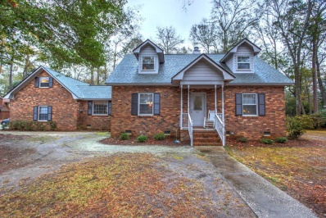
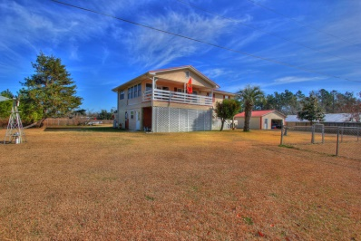
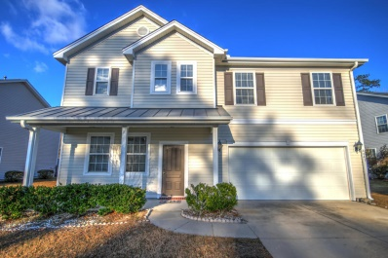
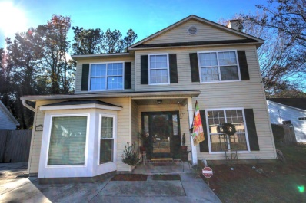
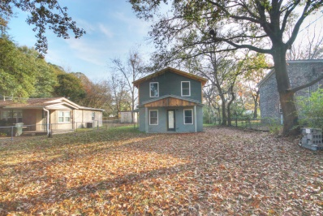
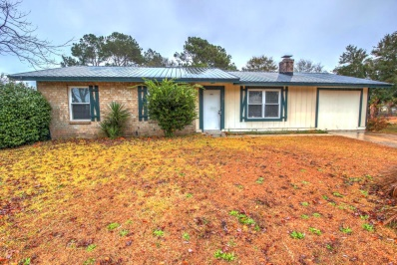
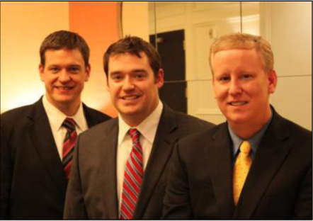

ChuckTown Homes New Listings!!
Under Contract in 6 Days!
Under Contract in 11 Days!
Under Contract in 11 Days!
Under Contract in 15 Days!
Ashborough
Summerville
$259,900
MLS# 14031027
Pineville
$139,900
MLS# 14031435
Click here to view listing
24-hour Information Hotline
888-210-3348 x2359
Click here to view listing
24-hour Information Hotline
888-210-3348 x2959
Wescott Plantation
Summerville
$265,000
MLS# 14031095
Hemmingwood
West Ashley
$200,000
MLS# 14031033
Click here to view listing
24-hour Information Hotline
888-210-3348 x2999
Click here to view listing
24-hour Information Hotline
888-210-3348 x2379
Ardmore
West Ashley
$100,000
MLS# 14030807
Conifer Hall
Moncks Corner
$100,000
MLS# 14031035
Click here to view listing
24-hour Information Hotline
888-210-3348 x2329
Click here to view listing
24-hour Information Hotline
888-210-3348 x2549
The ChuckTown Homes Team
Owners:
Donald Russell, Jeremy Wilson, Shawn Pillion
Buyers Specialists:
Andrea Parler, Tammie Phillips, Polly Cillpam, Ashley Towns, Katie McClure and Steve Baller
Phone: 888-210-3348
info@chucktownhomes.com
www.chucktownhomes.com

