Slide 1
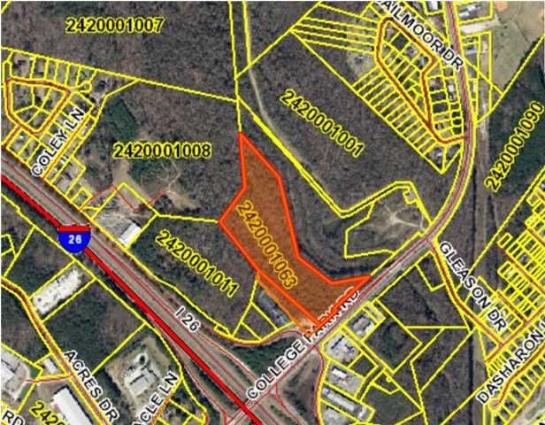

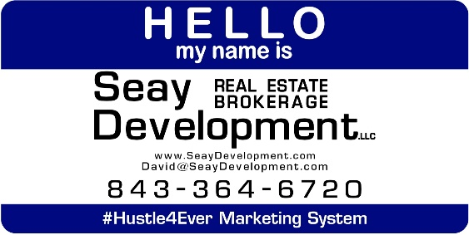
CIRCLE S ENTERPRISES
COLLEGE PARK RD
Ladson, SC 29456
VACANT LAND FOR SALE
17.63 Acres consisting of two parcels (242-00-01-063 & 242-08-01-001) very close to
I-26 off College Park Road. The parcels are adjacent and are priced at $100,000 per acre. Berkeley County has approximately 195,000 residents.
Catylist ID: | #29853923
Gross Land Area: | 17.63 Acres
Sale Price: | $1,763,000
Unit Price: | $100,000 Per Acre
Zoning: | GENERAL COMMERCIAL/FLEX
Submarket/Township: | 74 - Jedburg Rd-Black Tom-Hwy.17a-Col.Pk.
Sale Terms: | Cash to Seller, Other
County: | Berkeley
Tax ID/APN: | 242-00-01-063
David H Seay
CCIM, BIC, CCIM, REALTOR
(843) 364-6720
david@seaydevelopment.com
Seay Development, LLC
3404-202A Salterbeck Street
Mt. Pleasant, SC 29466
www.seaydevelopment.com

